Slide 1




Size matters: how patch size influences meta-ecosystem dynamics. A progress report from the world of protists.
Emanuele Giacomuzzo

Slide 2

FUNCTION
http://www.fonsvanderplas.nl/research/
Notes:
- We want to study ecosystem function
Local BEF

Slide 3
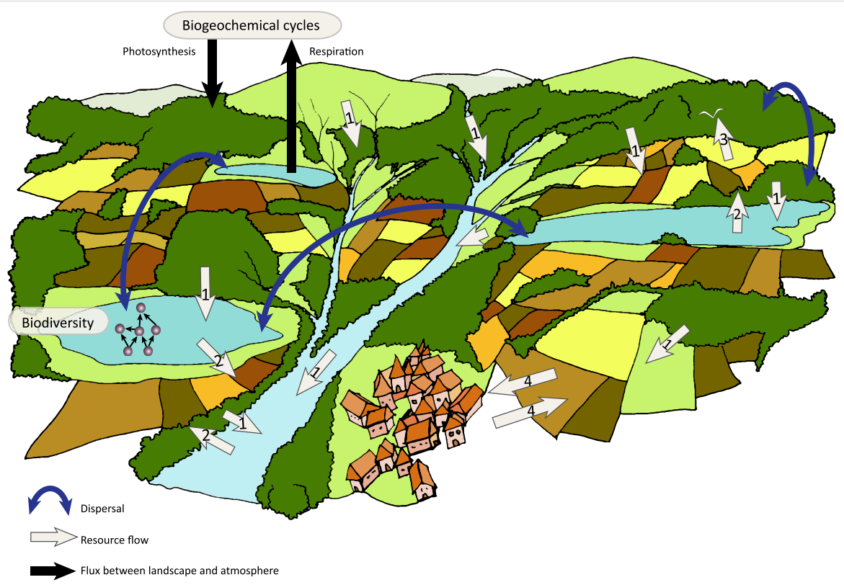
FUNCTION
Gounand, I., Harvey, E., Little, C. J., & Altermatt, F. (2018). Meta-ecosystems 2.0: rooting the theory into the field. Trends in Ecology & Evolution, 33(1), 36-46.
Notes:
- Real world
Scaling up: alpha diversity, BEF relationship, habitat diversity
Scaling up: nutrient flows
Introduce meta-ecosystems
Nutrient flow effects: partitioning of nutrients, connectivity, network topology, …
Need to consider patch size, as it can have effects on resource quality and quantity and effects received
To understand meta-ecosystems we need to understand patch size
Patch-size dependent properties that could change meta-ecosystem dynamics

Slide 4
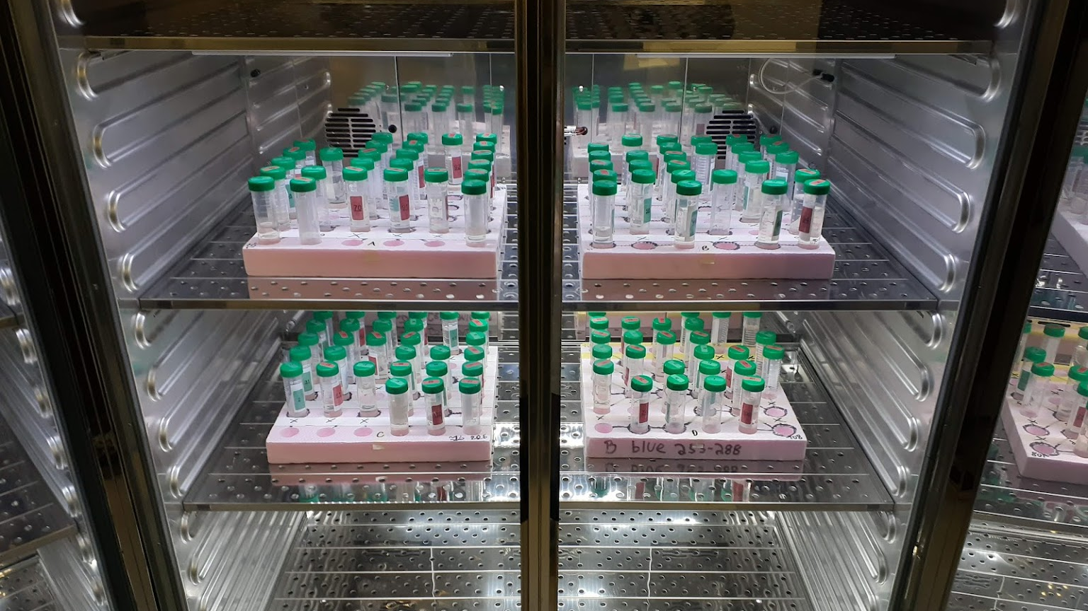

Slide 5
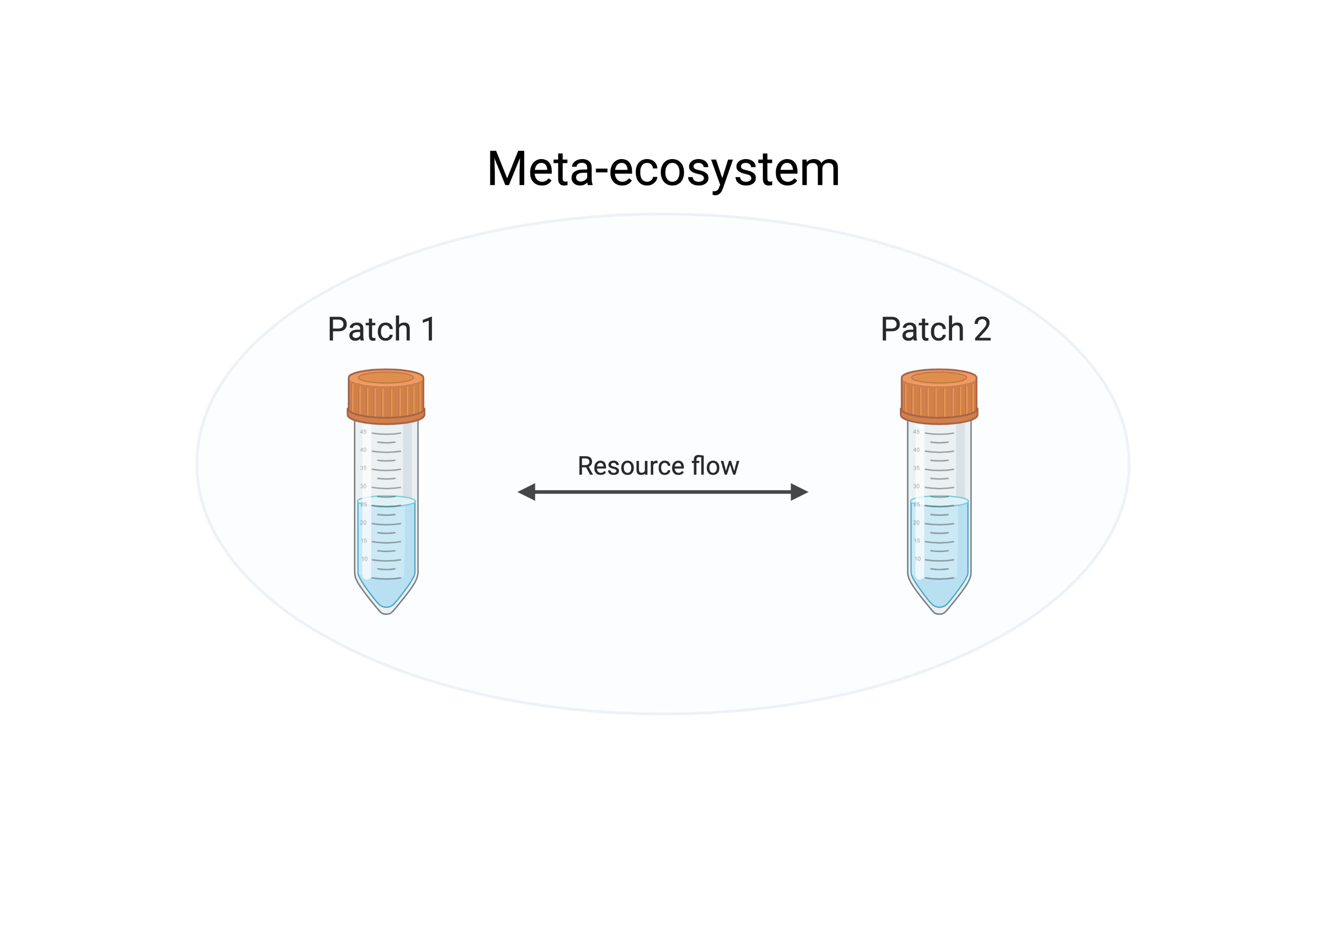
Add how the flow was created
Add community composition
*
*Resource: dead stuff (detritus, nutrients)

Slide 6
Ecosystem function = Biomass = Productivity

Slide 7
Experiment 1: effects of patch size

Slide 8
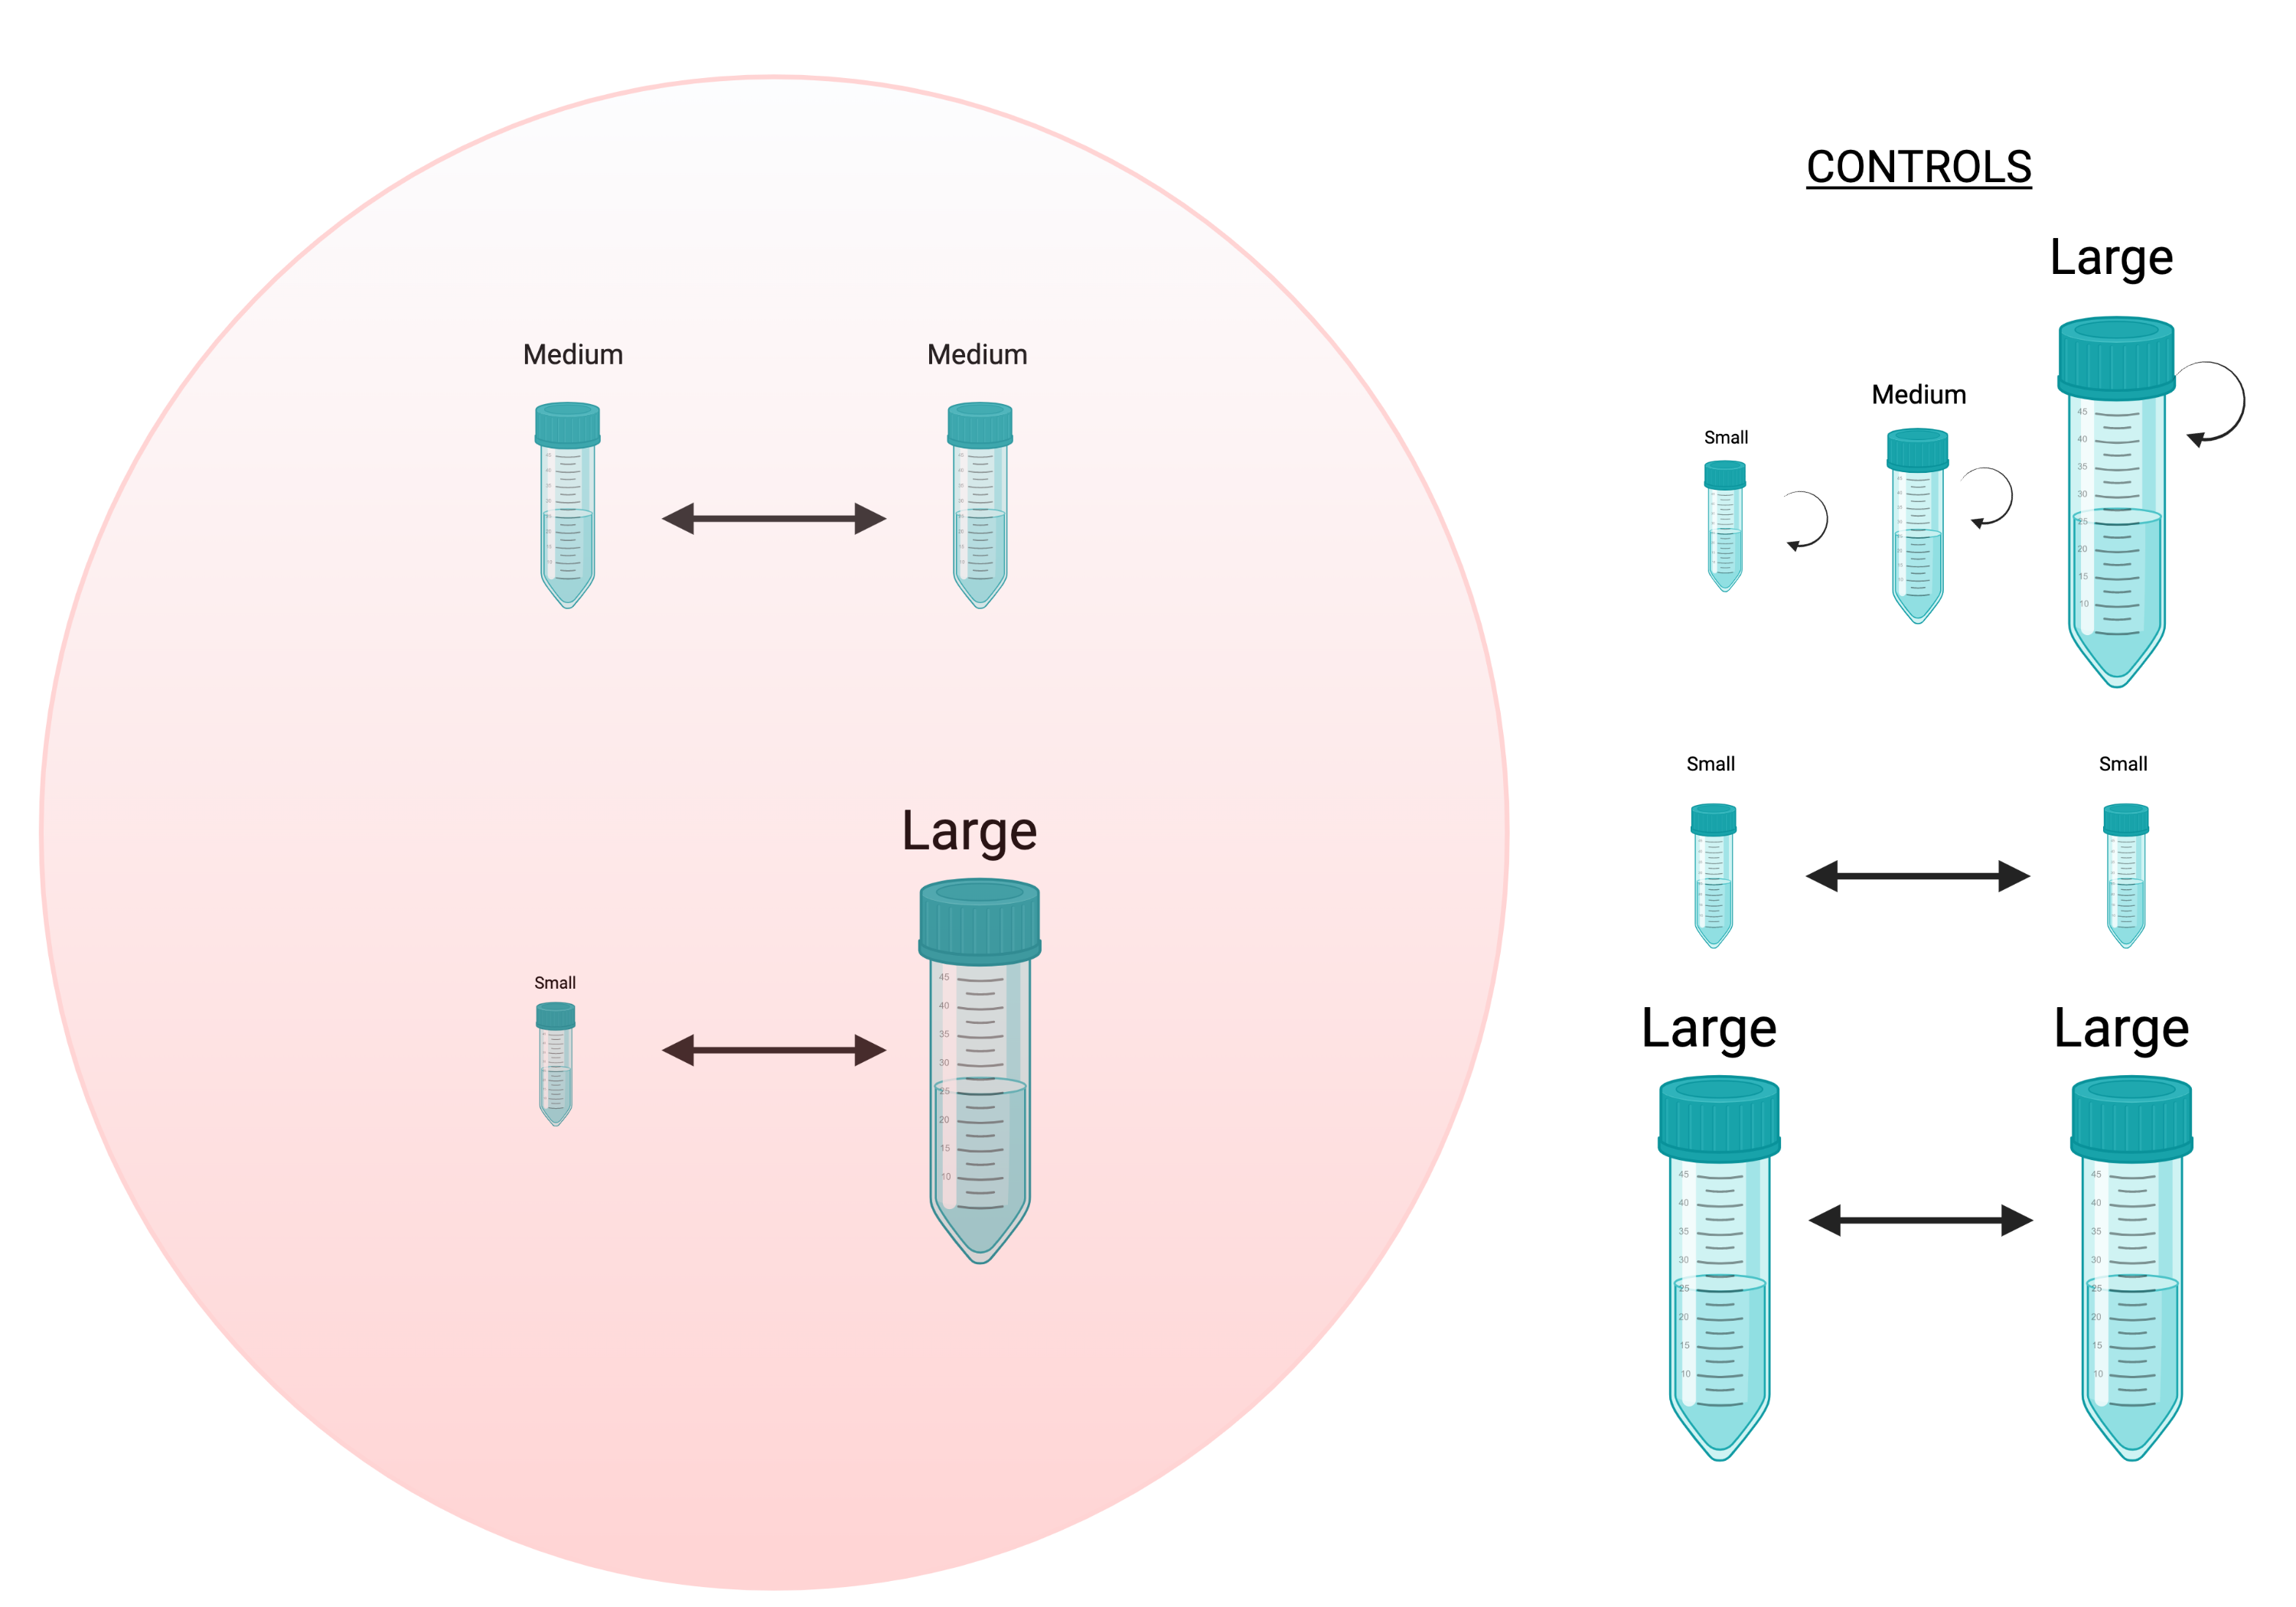
Add disturbance levels
5.25 ml
Same total volume
5.25 ml
5.25 ml
5.25 ml

Slide 9
Should I include day when modelling how effect size changes across time?
Should I leave the baseline or not?
Should I adjust for different sample size of the two effect sizes?
I need to add the results of Ble

Slide 10
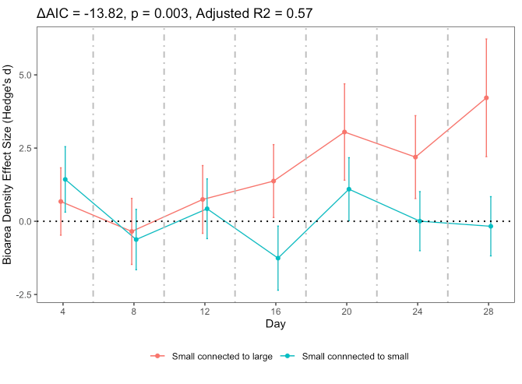
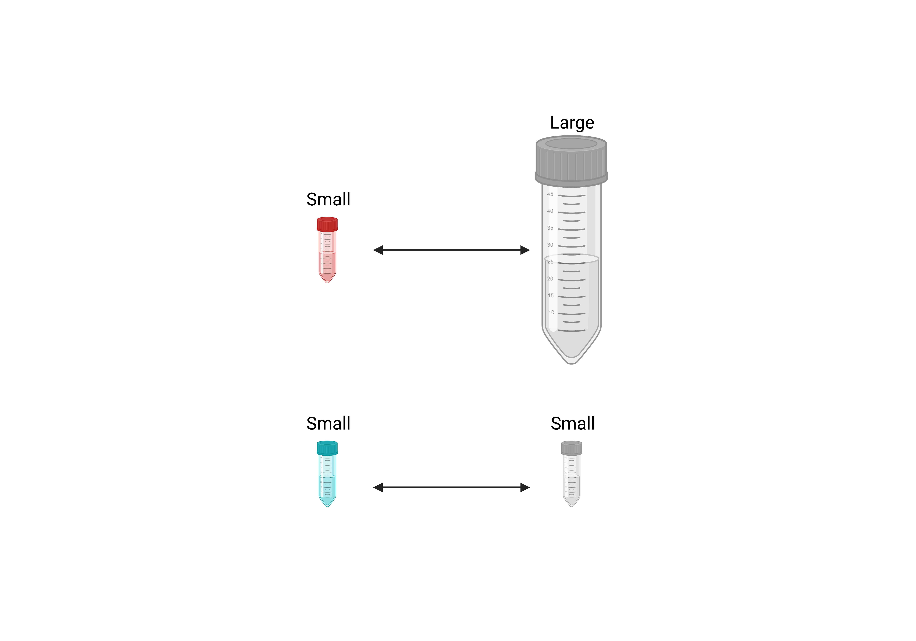
Patch biomass

Slide 11
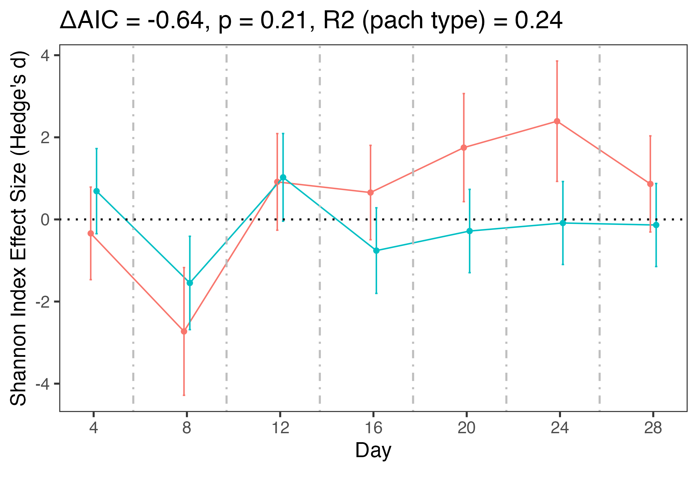
Patch Alpha Diversity

Slide 12
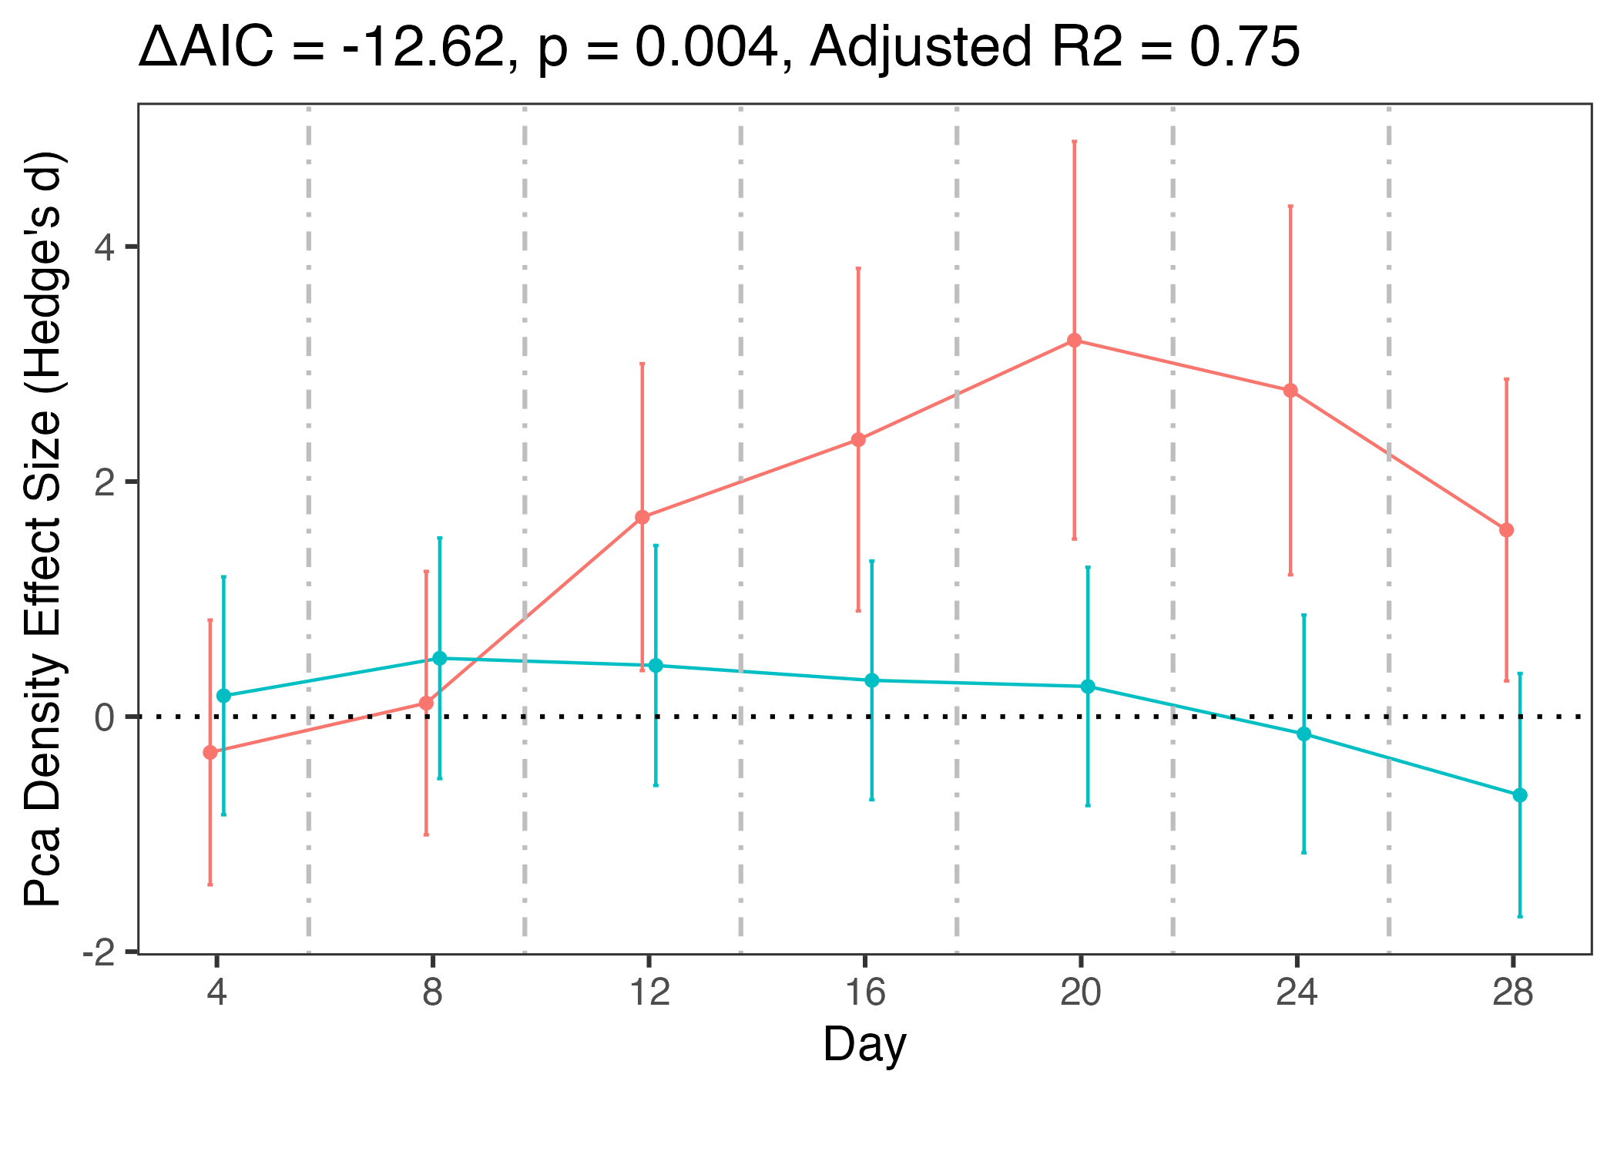
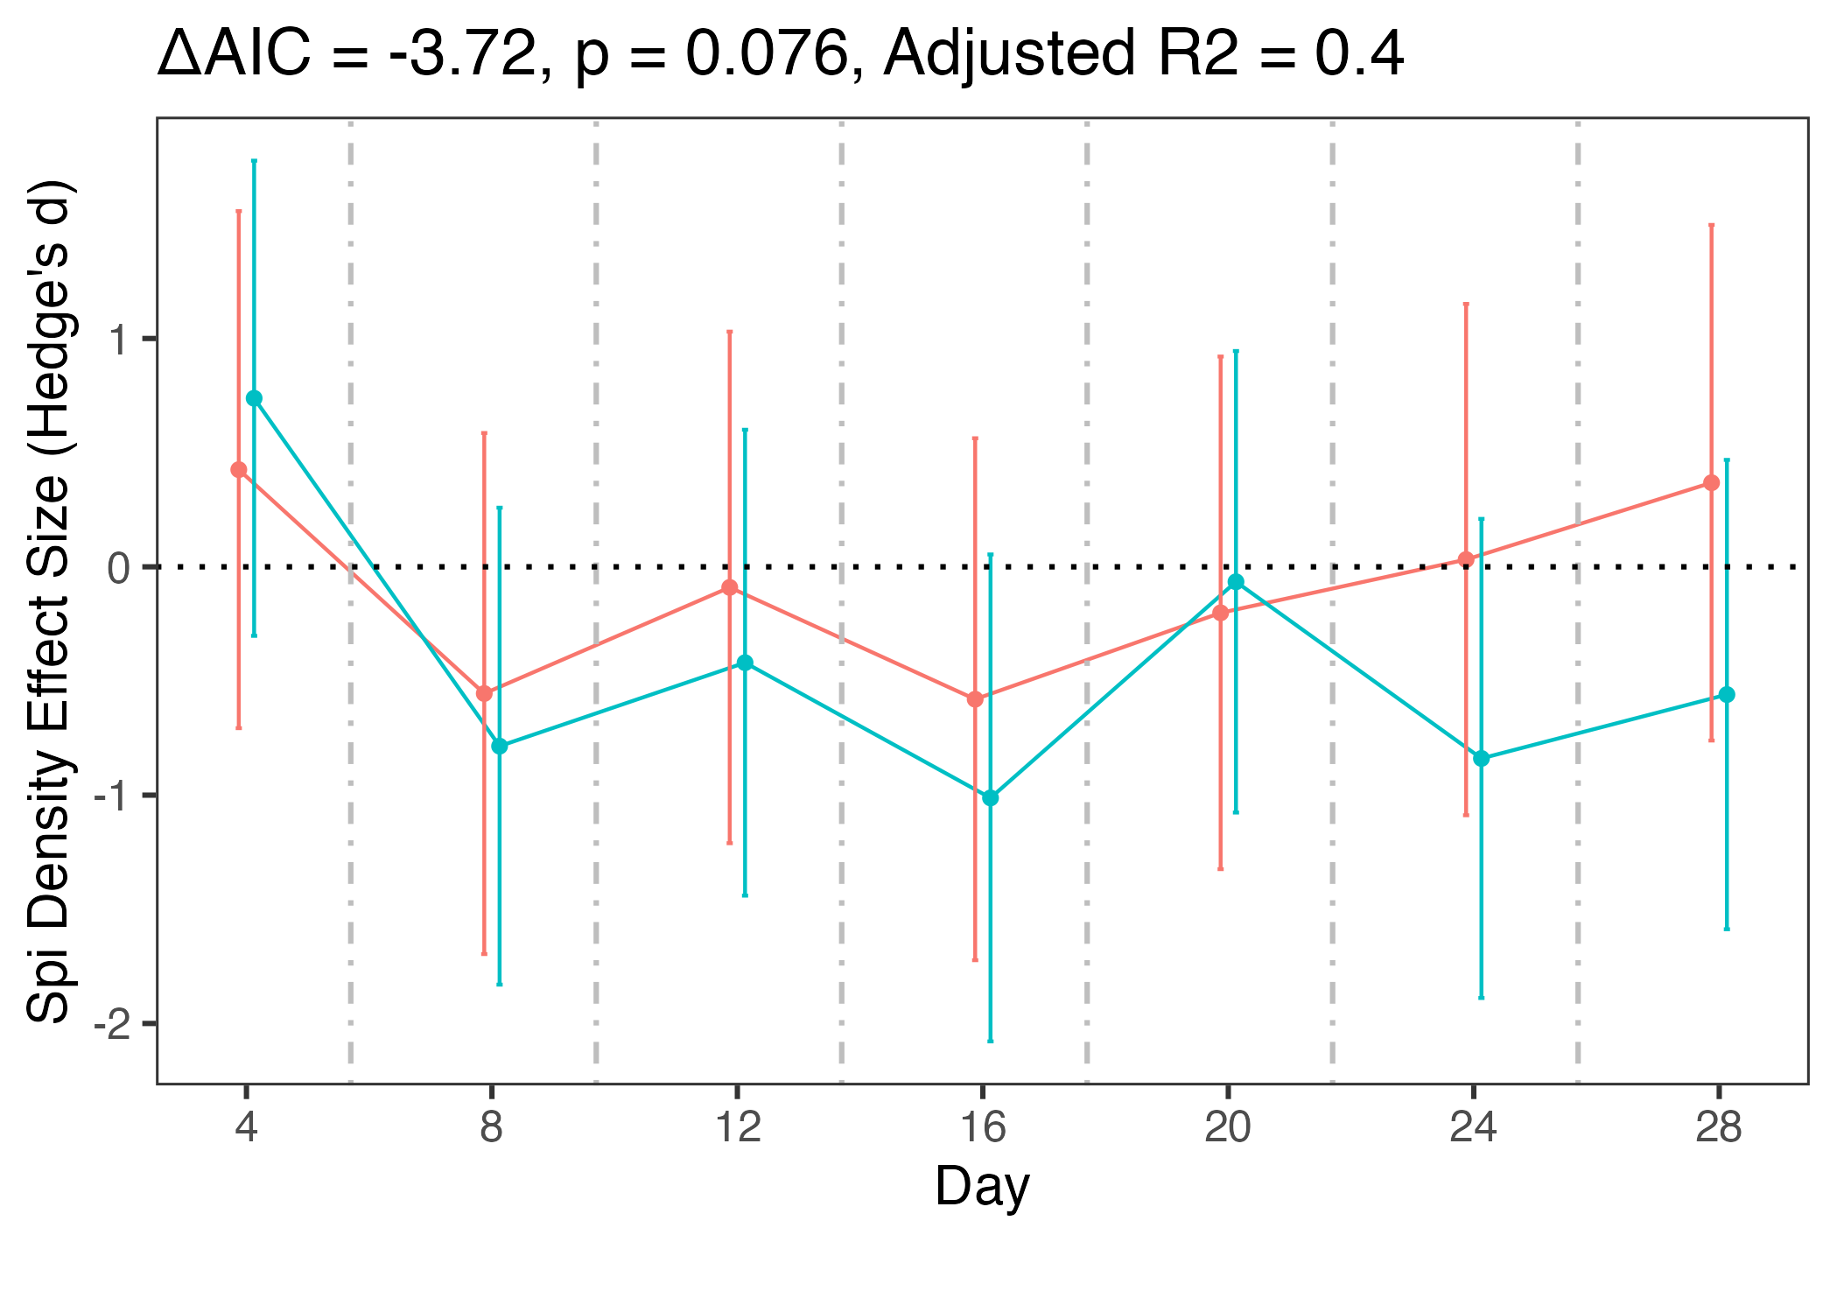
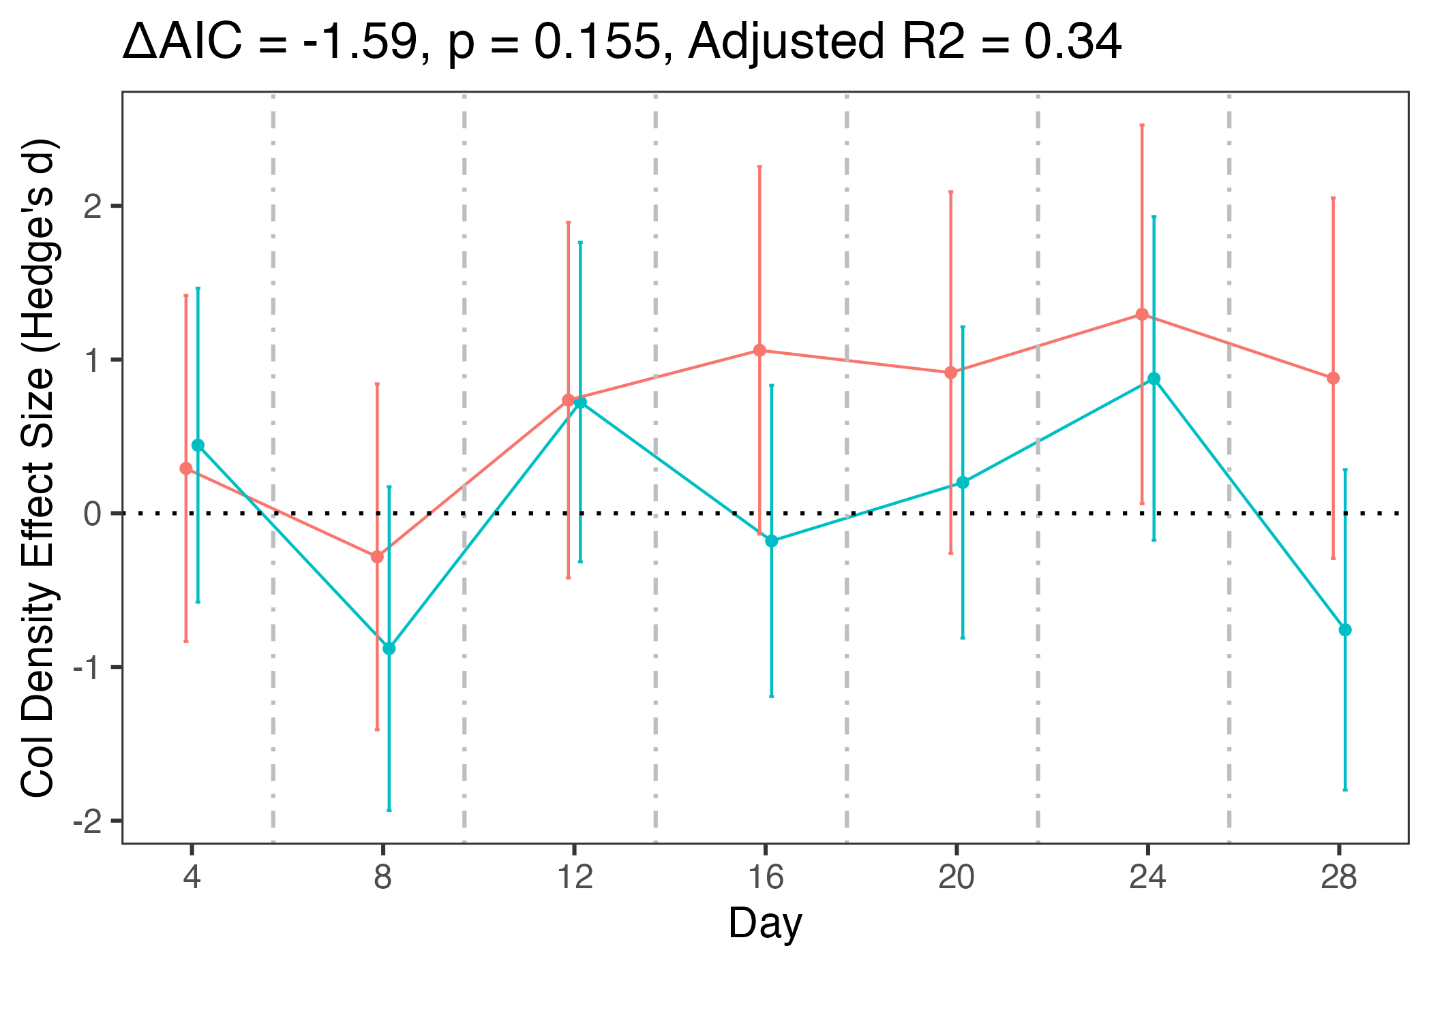
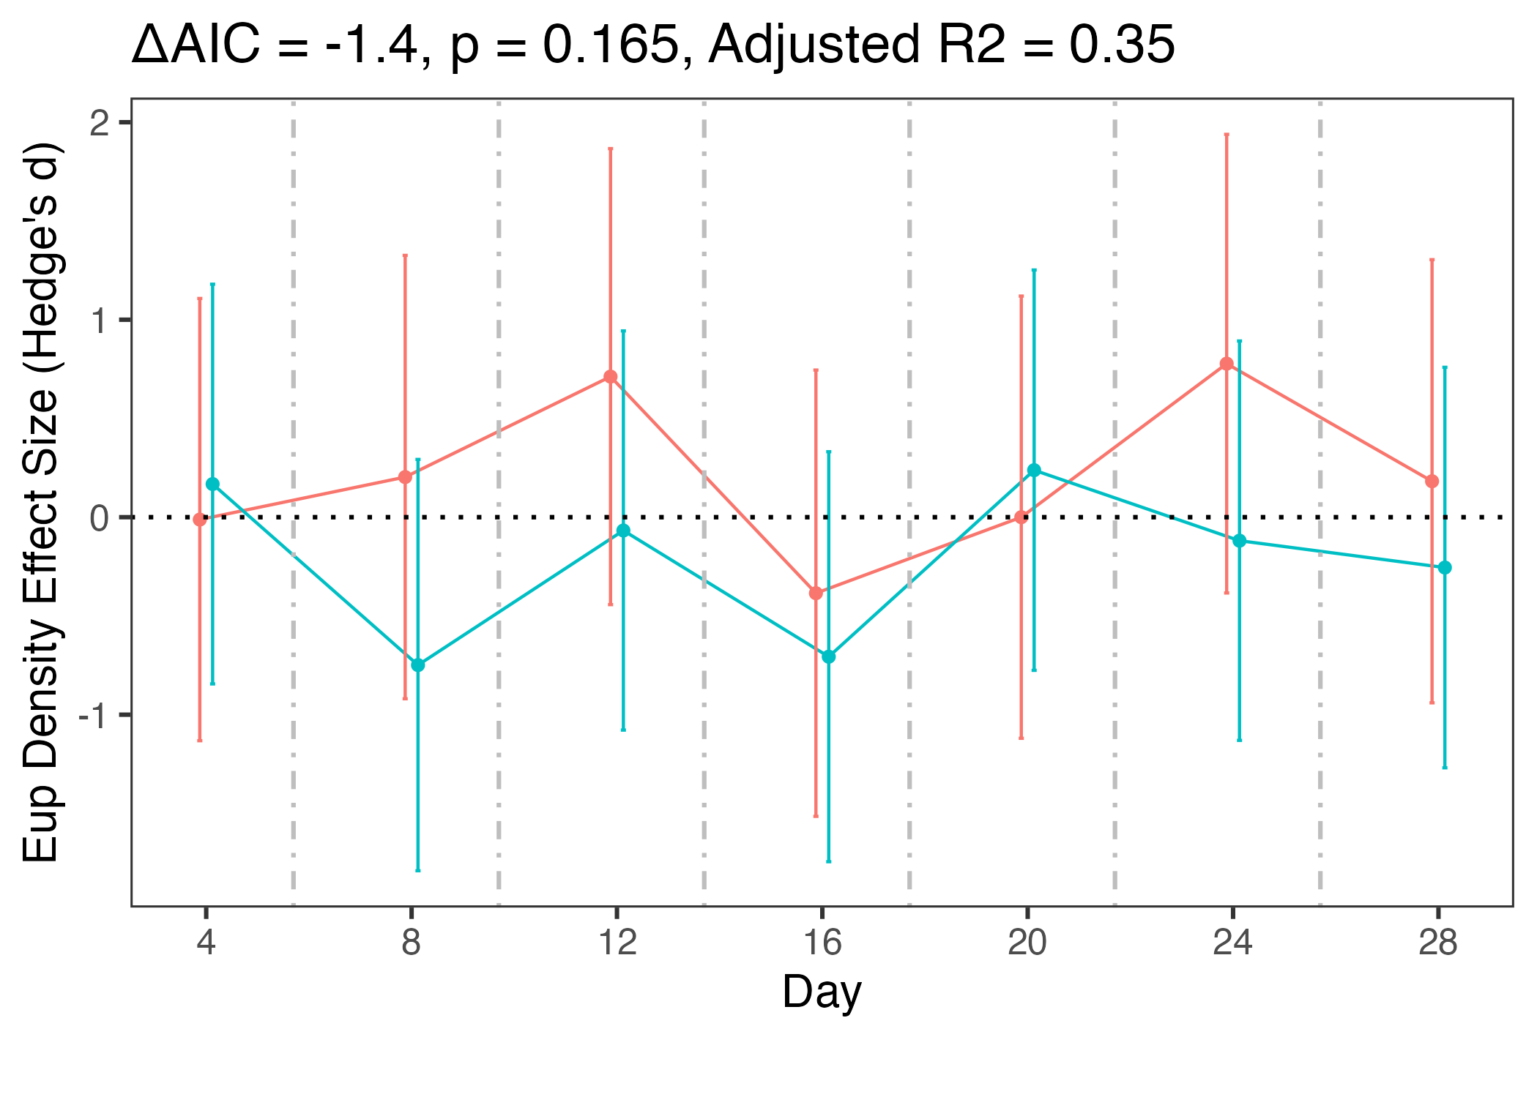
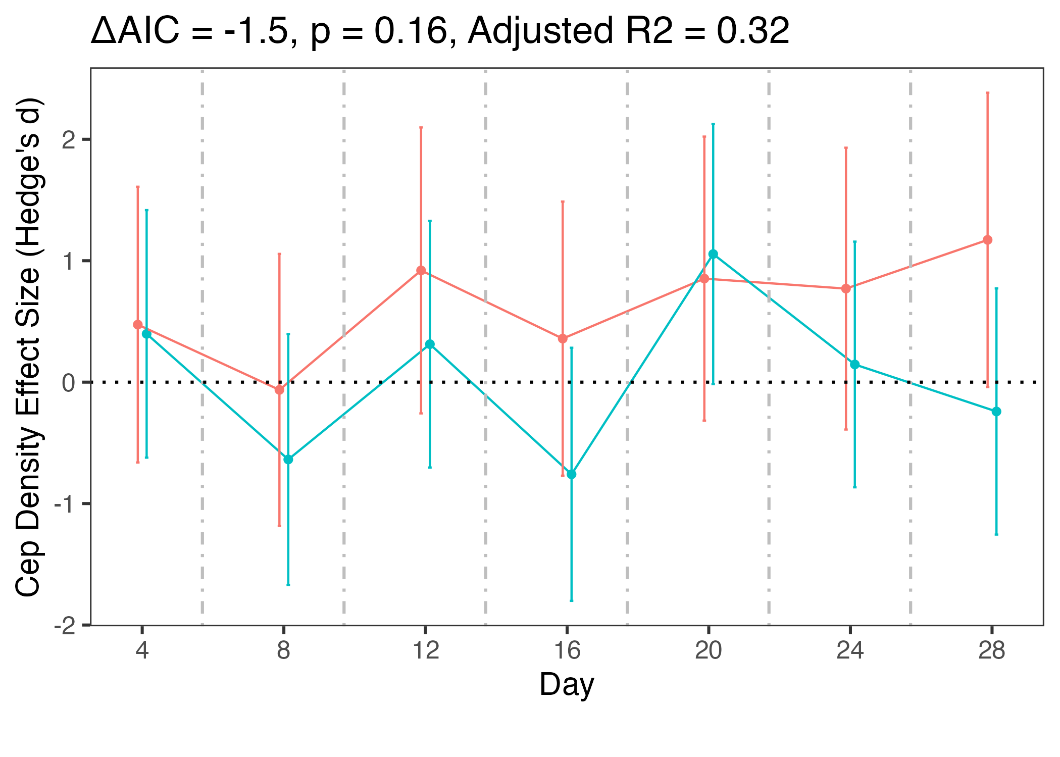
Species Densities: Effect

Slide 13
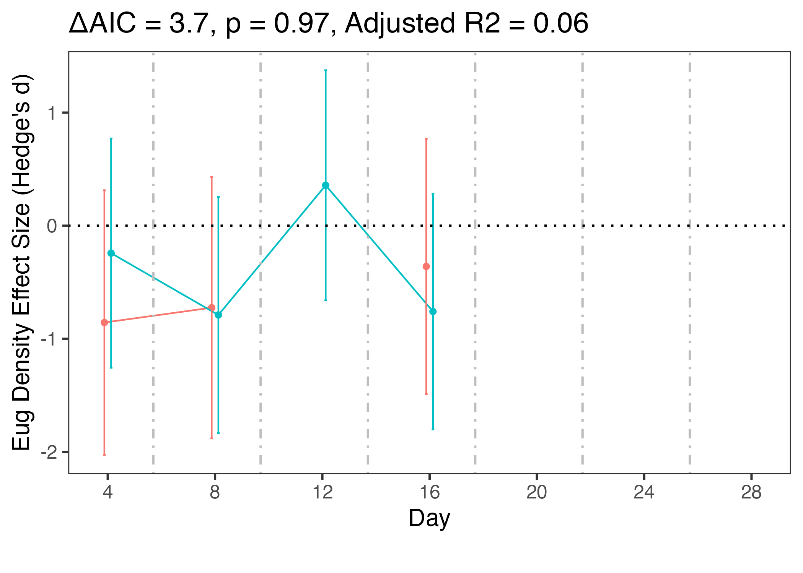
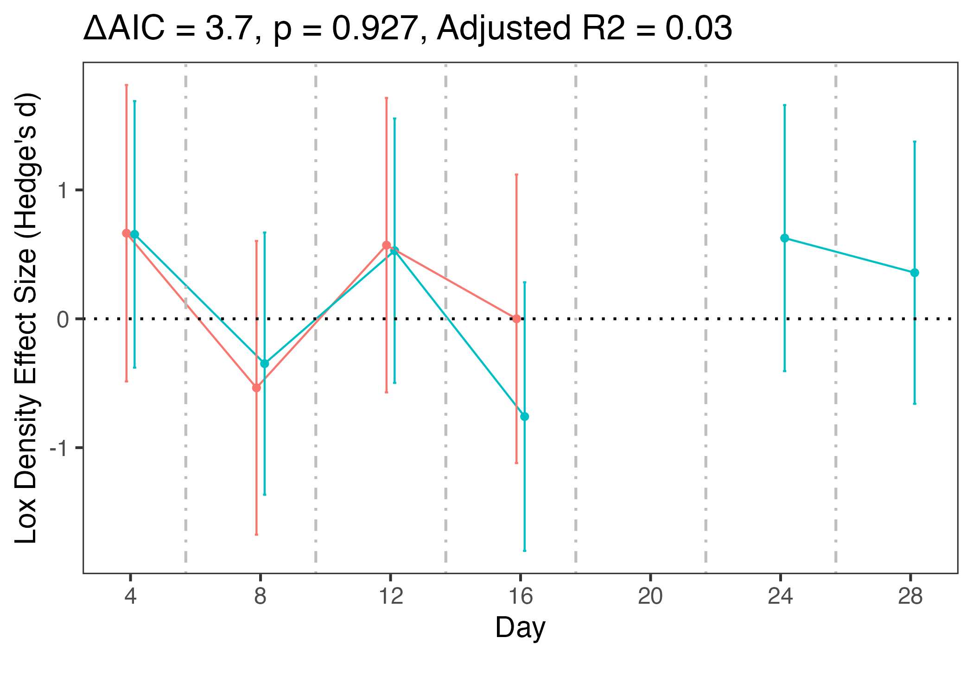
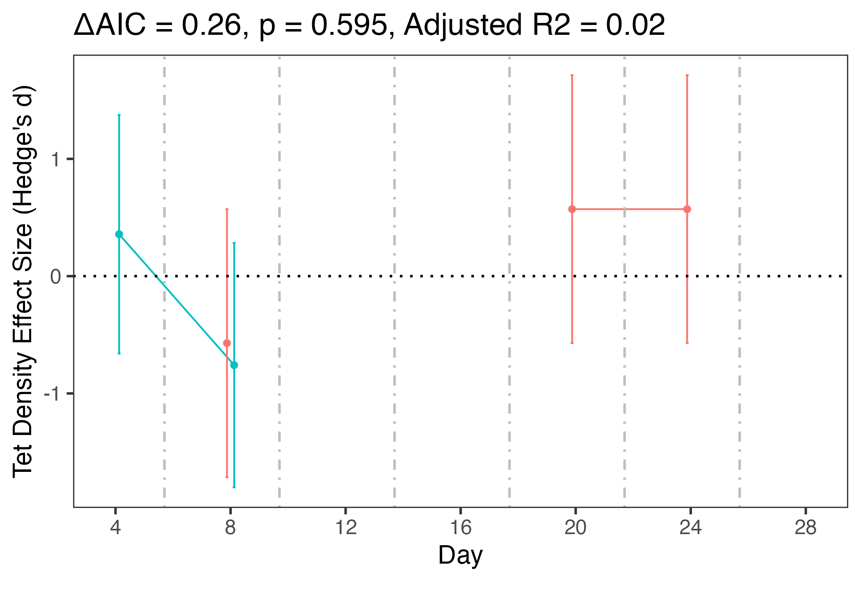
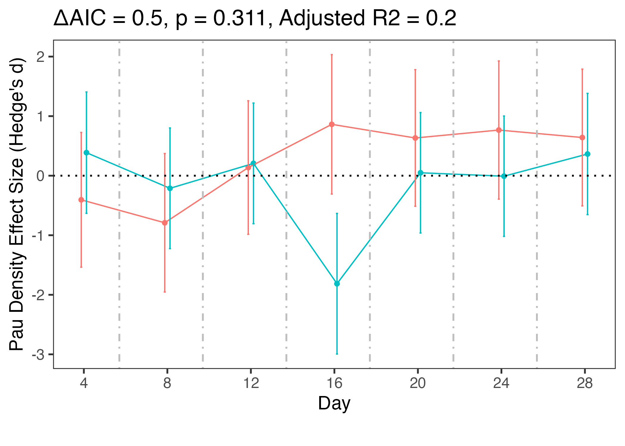
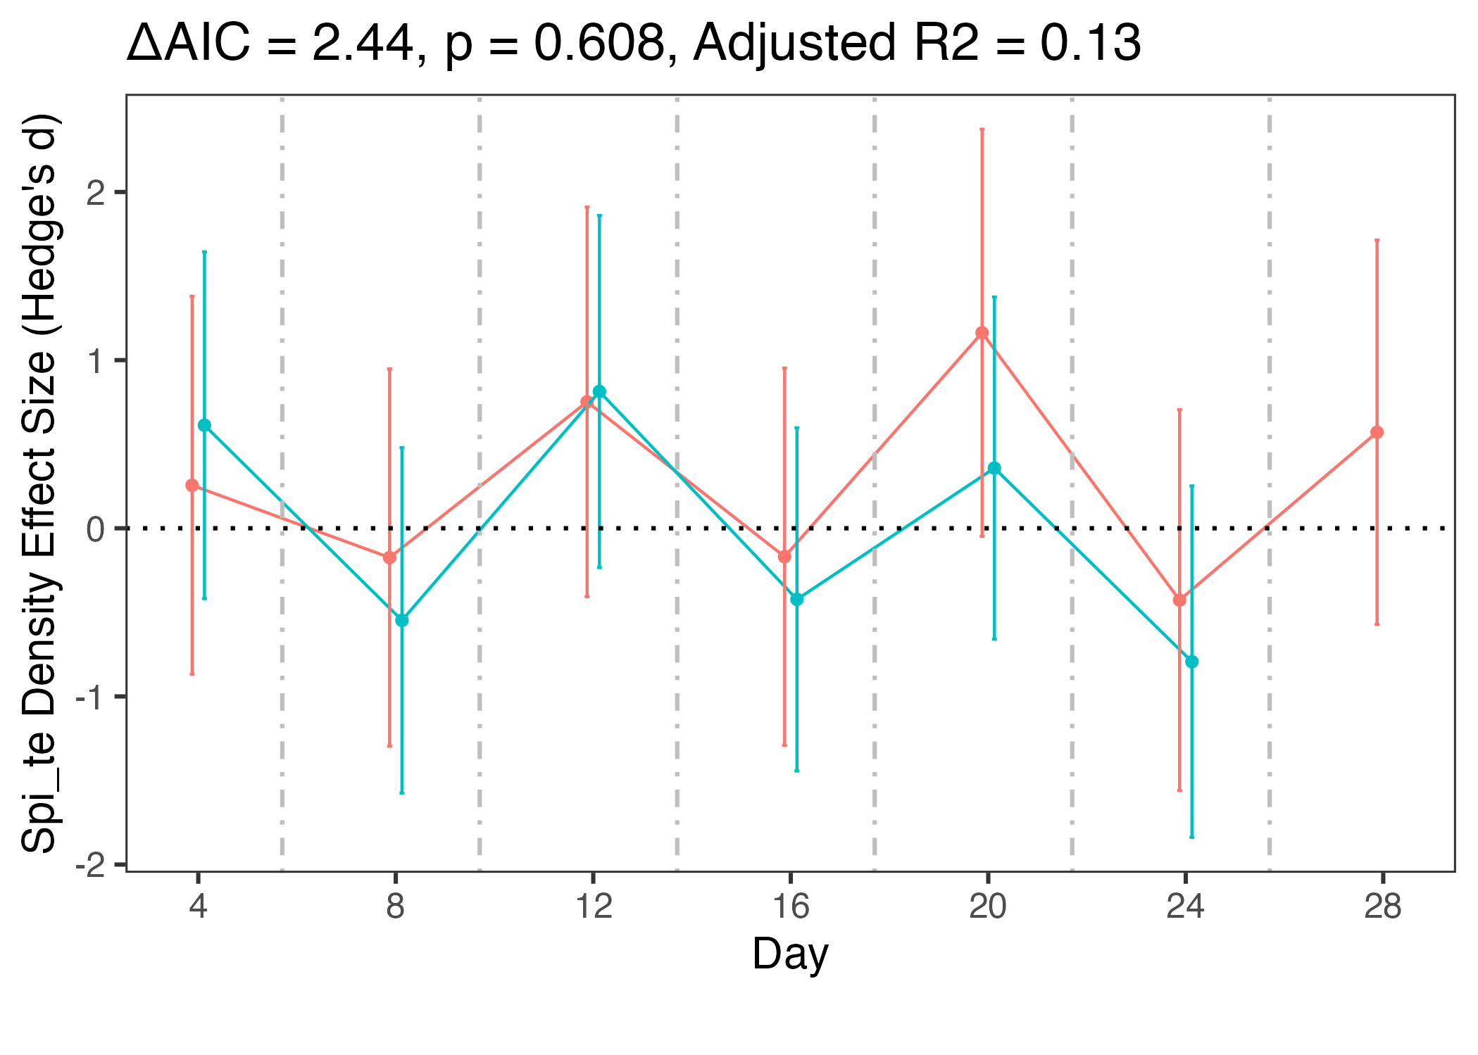
Species Densities: No effect

Slide 14
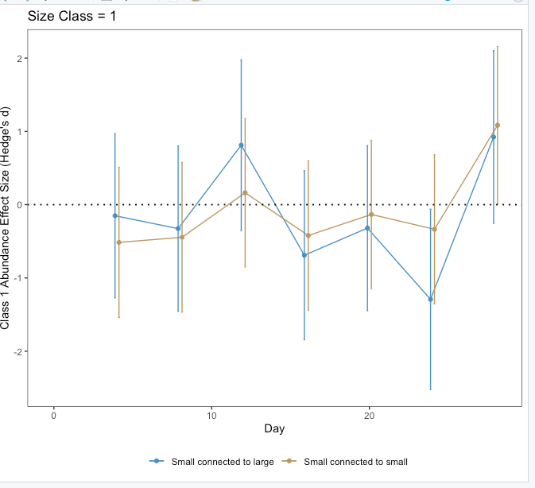
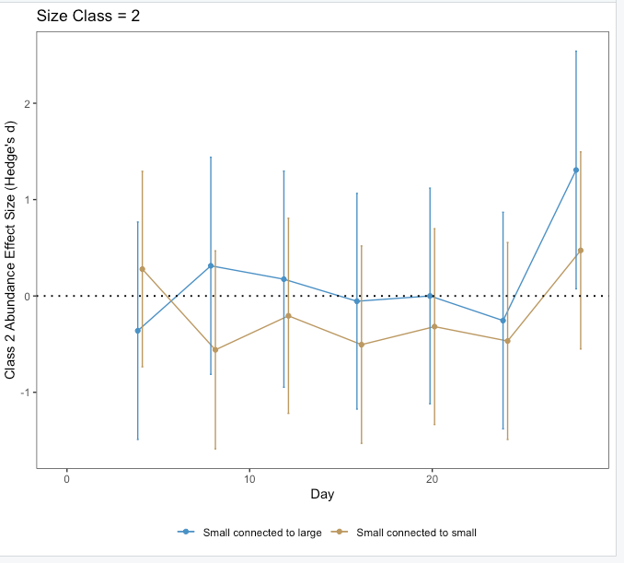
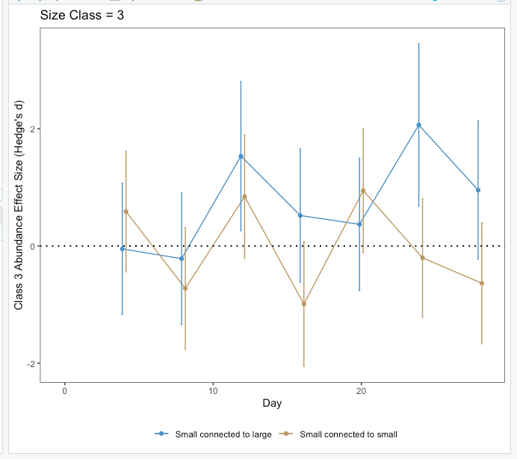
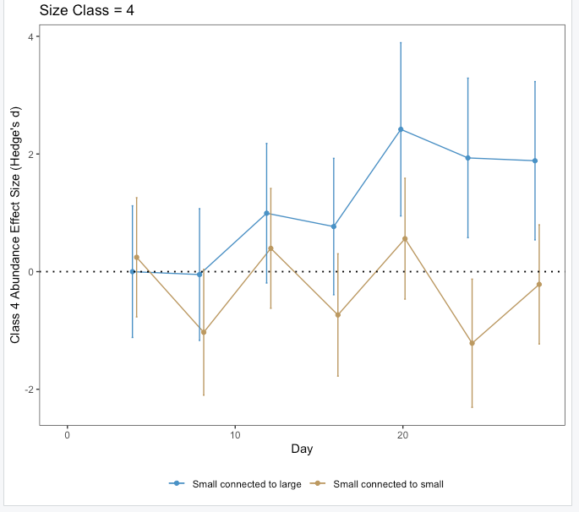
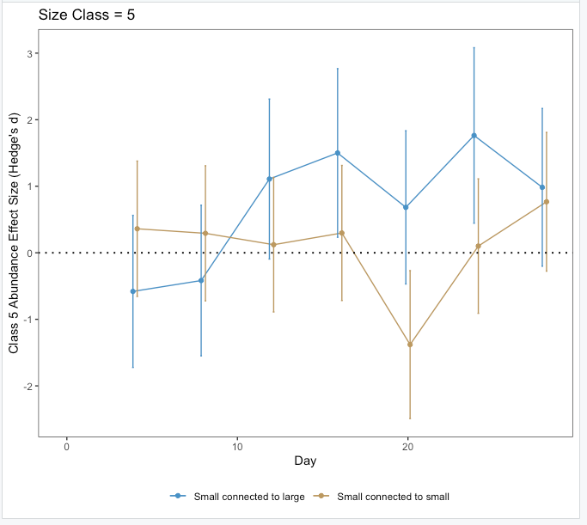
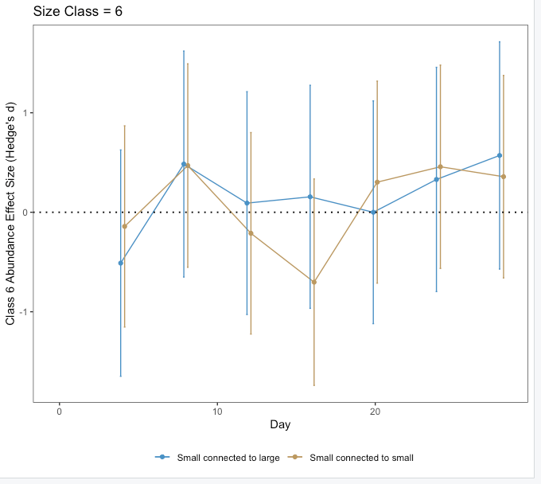
Size Classes

Slide 15
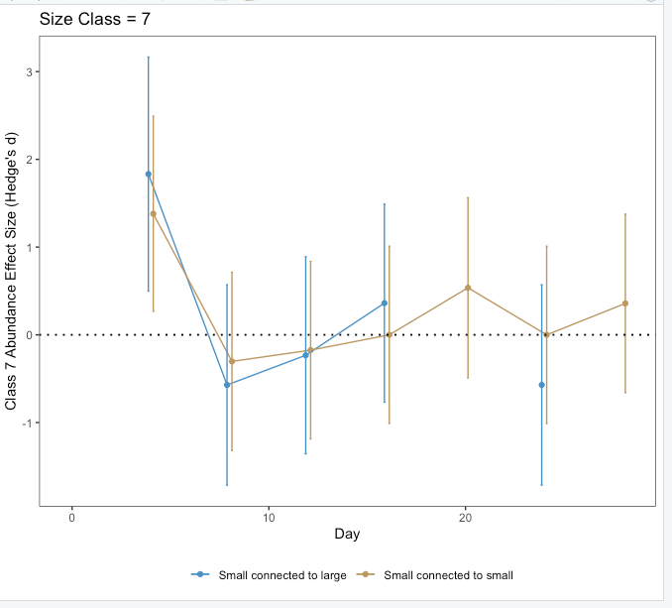
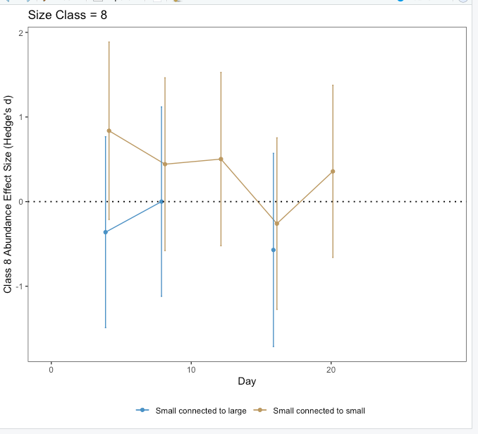
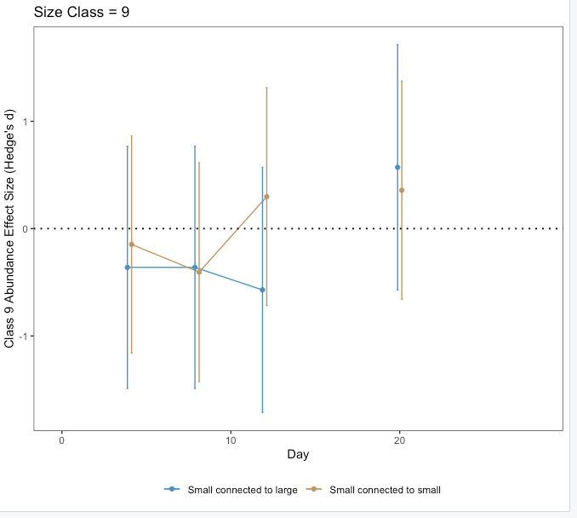
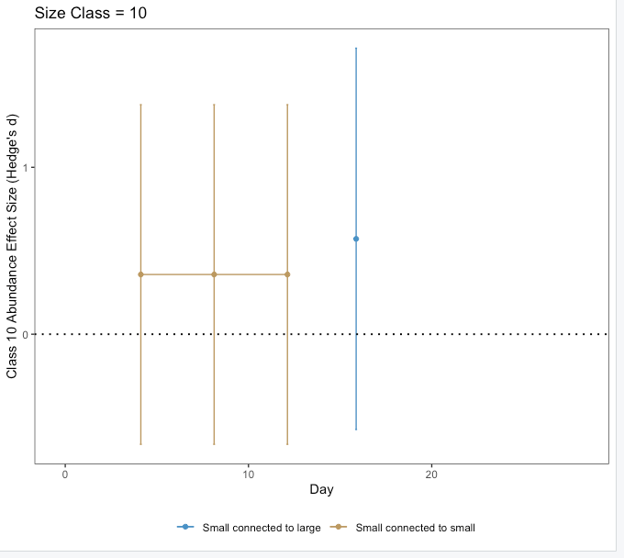
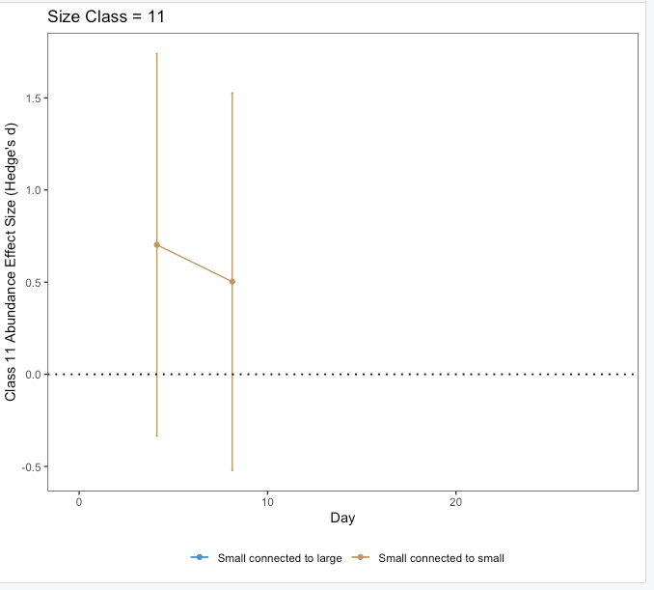
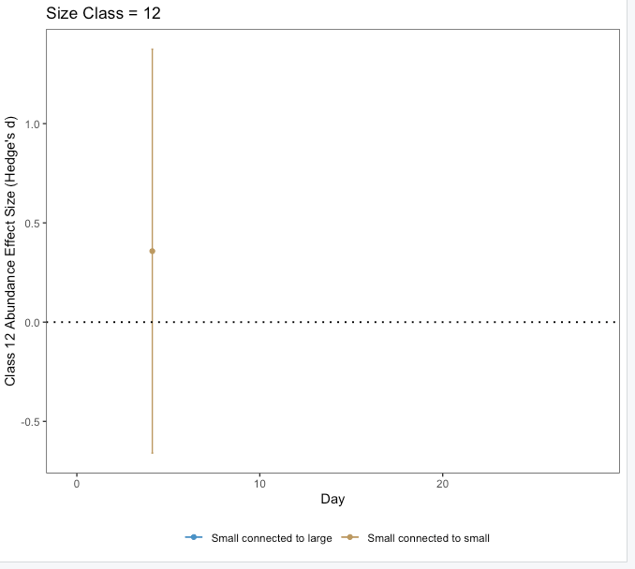

Slide 16
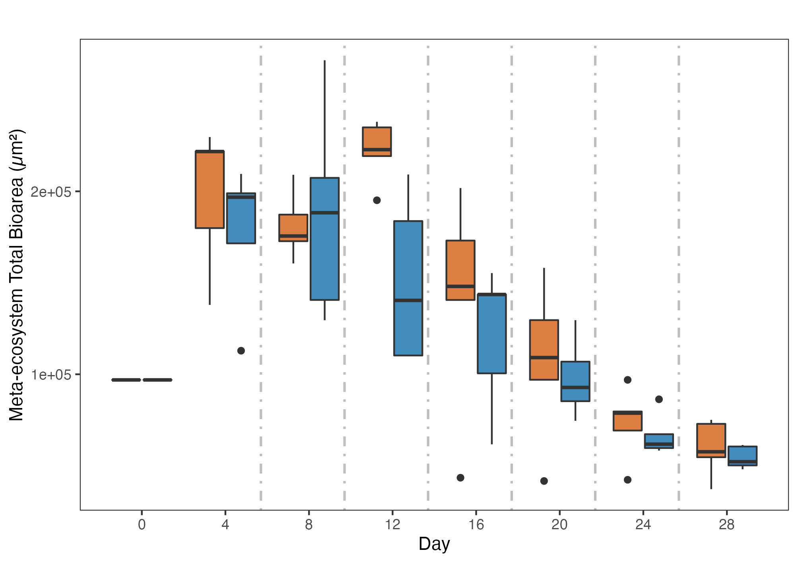
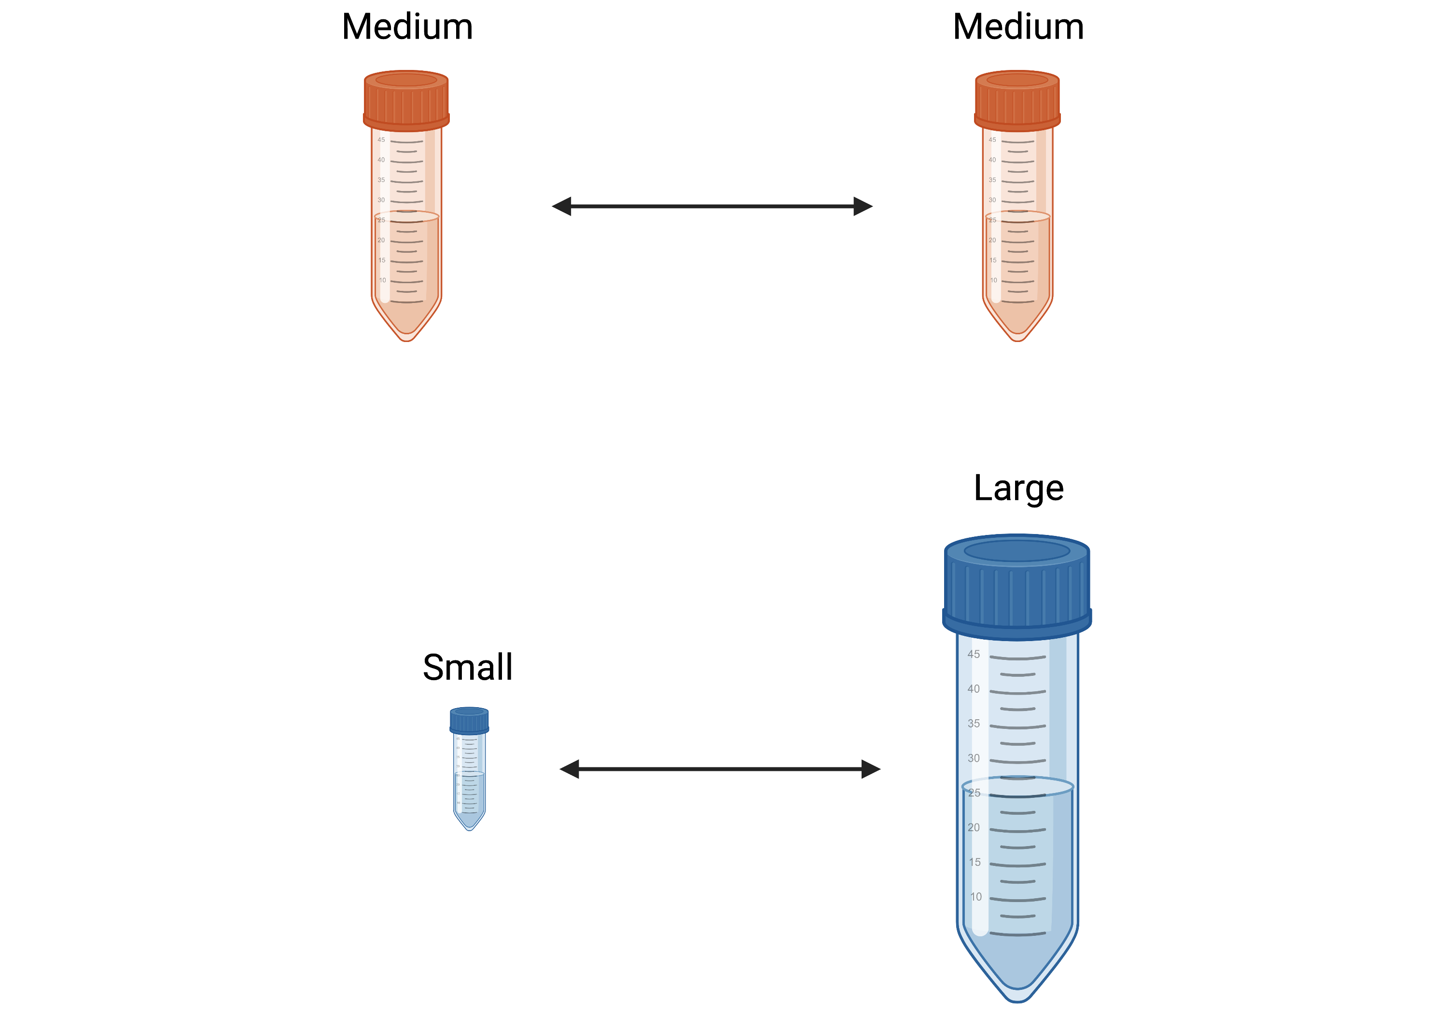
Meta-ecosystem biomass
No effect over whole time series (p = 0.15, ΔAIC = 0.7)
p = 0.018
ΔAIC = 6.72
R2 = 0.31
How do I interpret transient dynamic?
Flow
Flow
Flow
Flow
Flow
Flow
Notes:
- Different sample size.

Slide 17
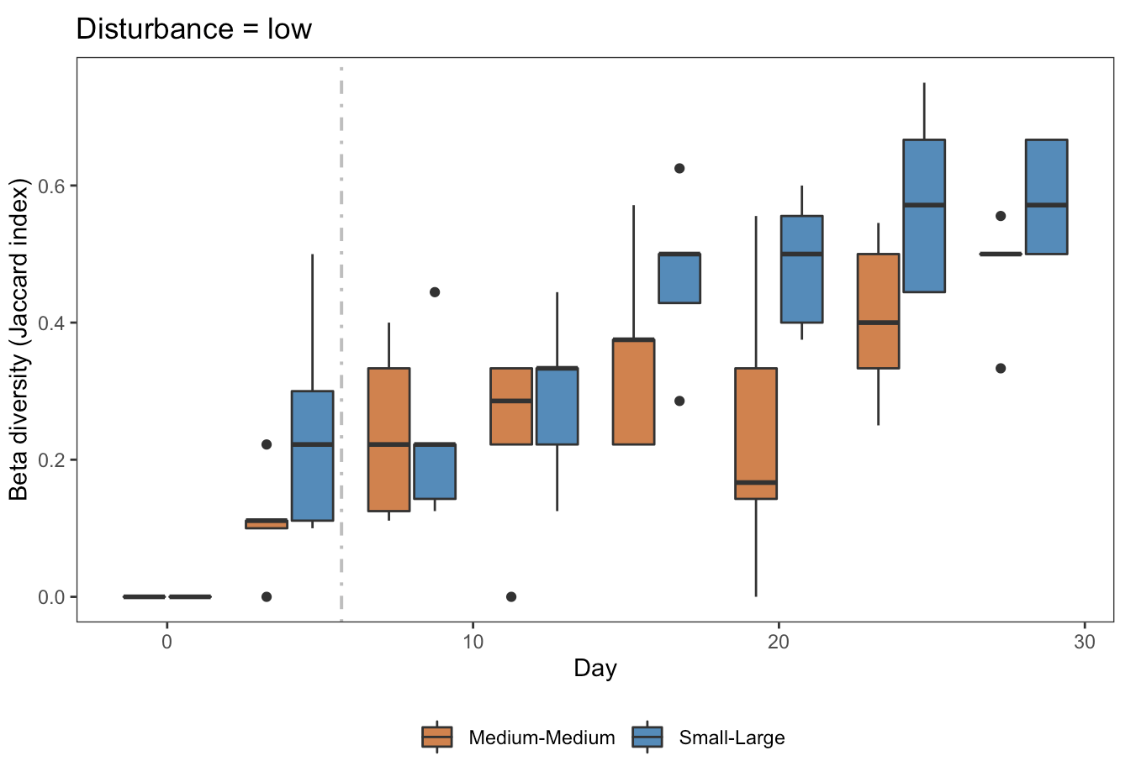
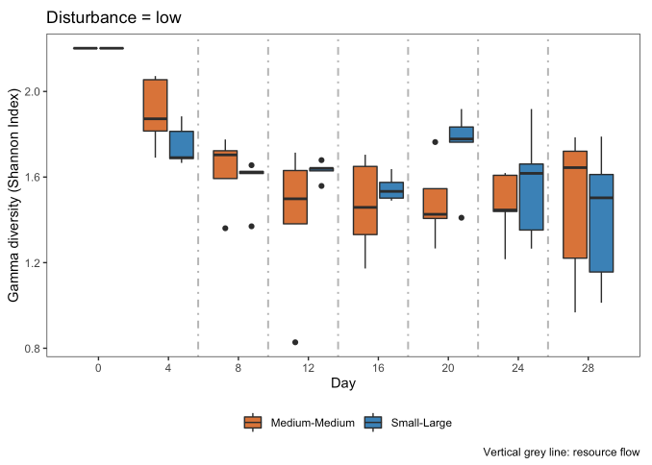
Beta diversity Gamma diversity
How do I interpret this?

Slide 18
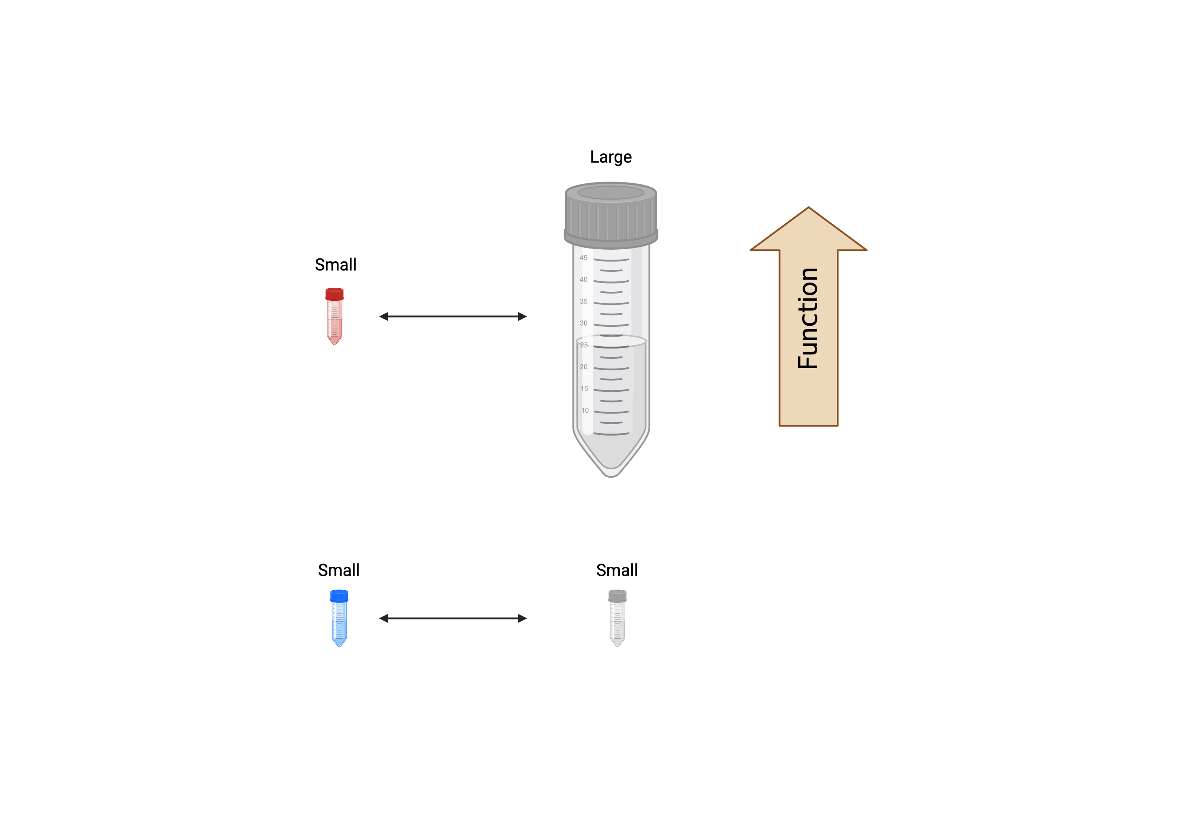
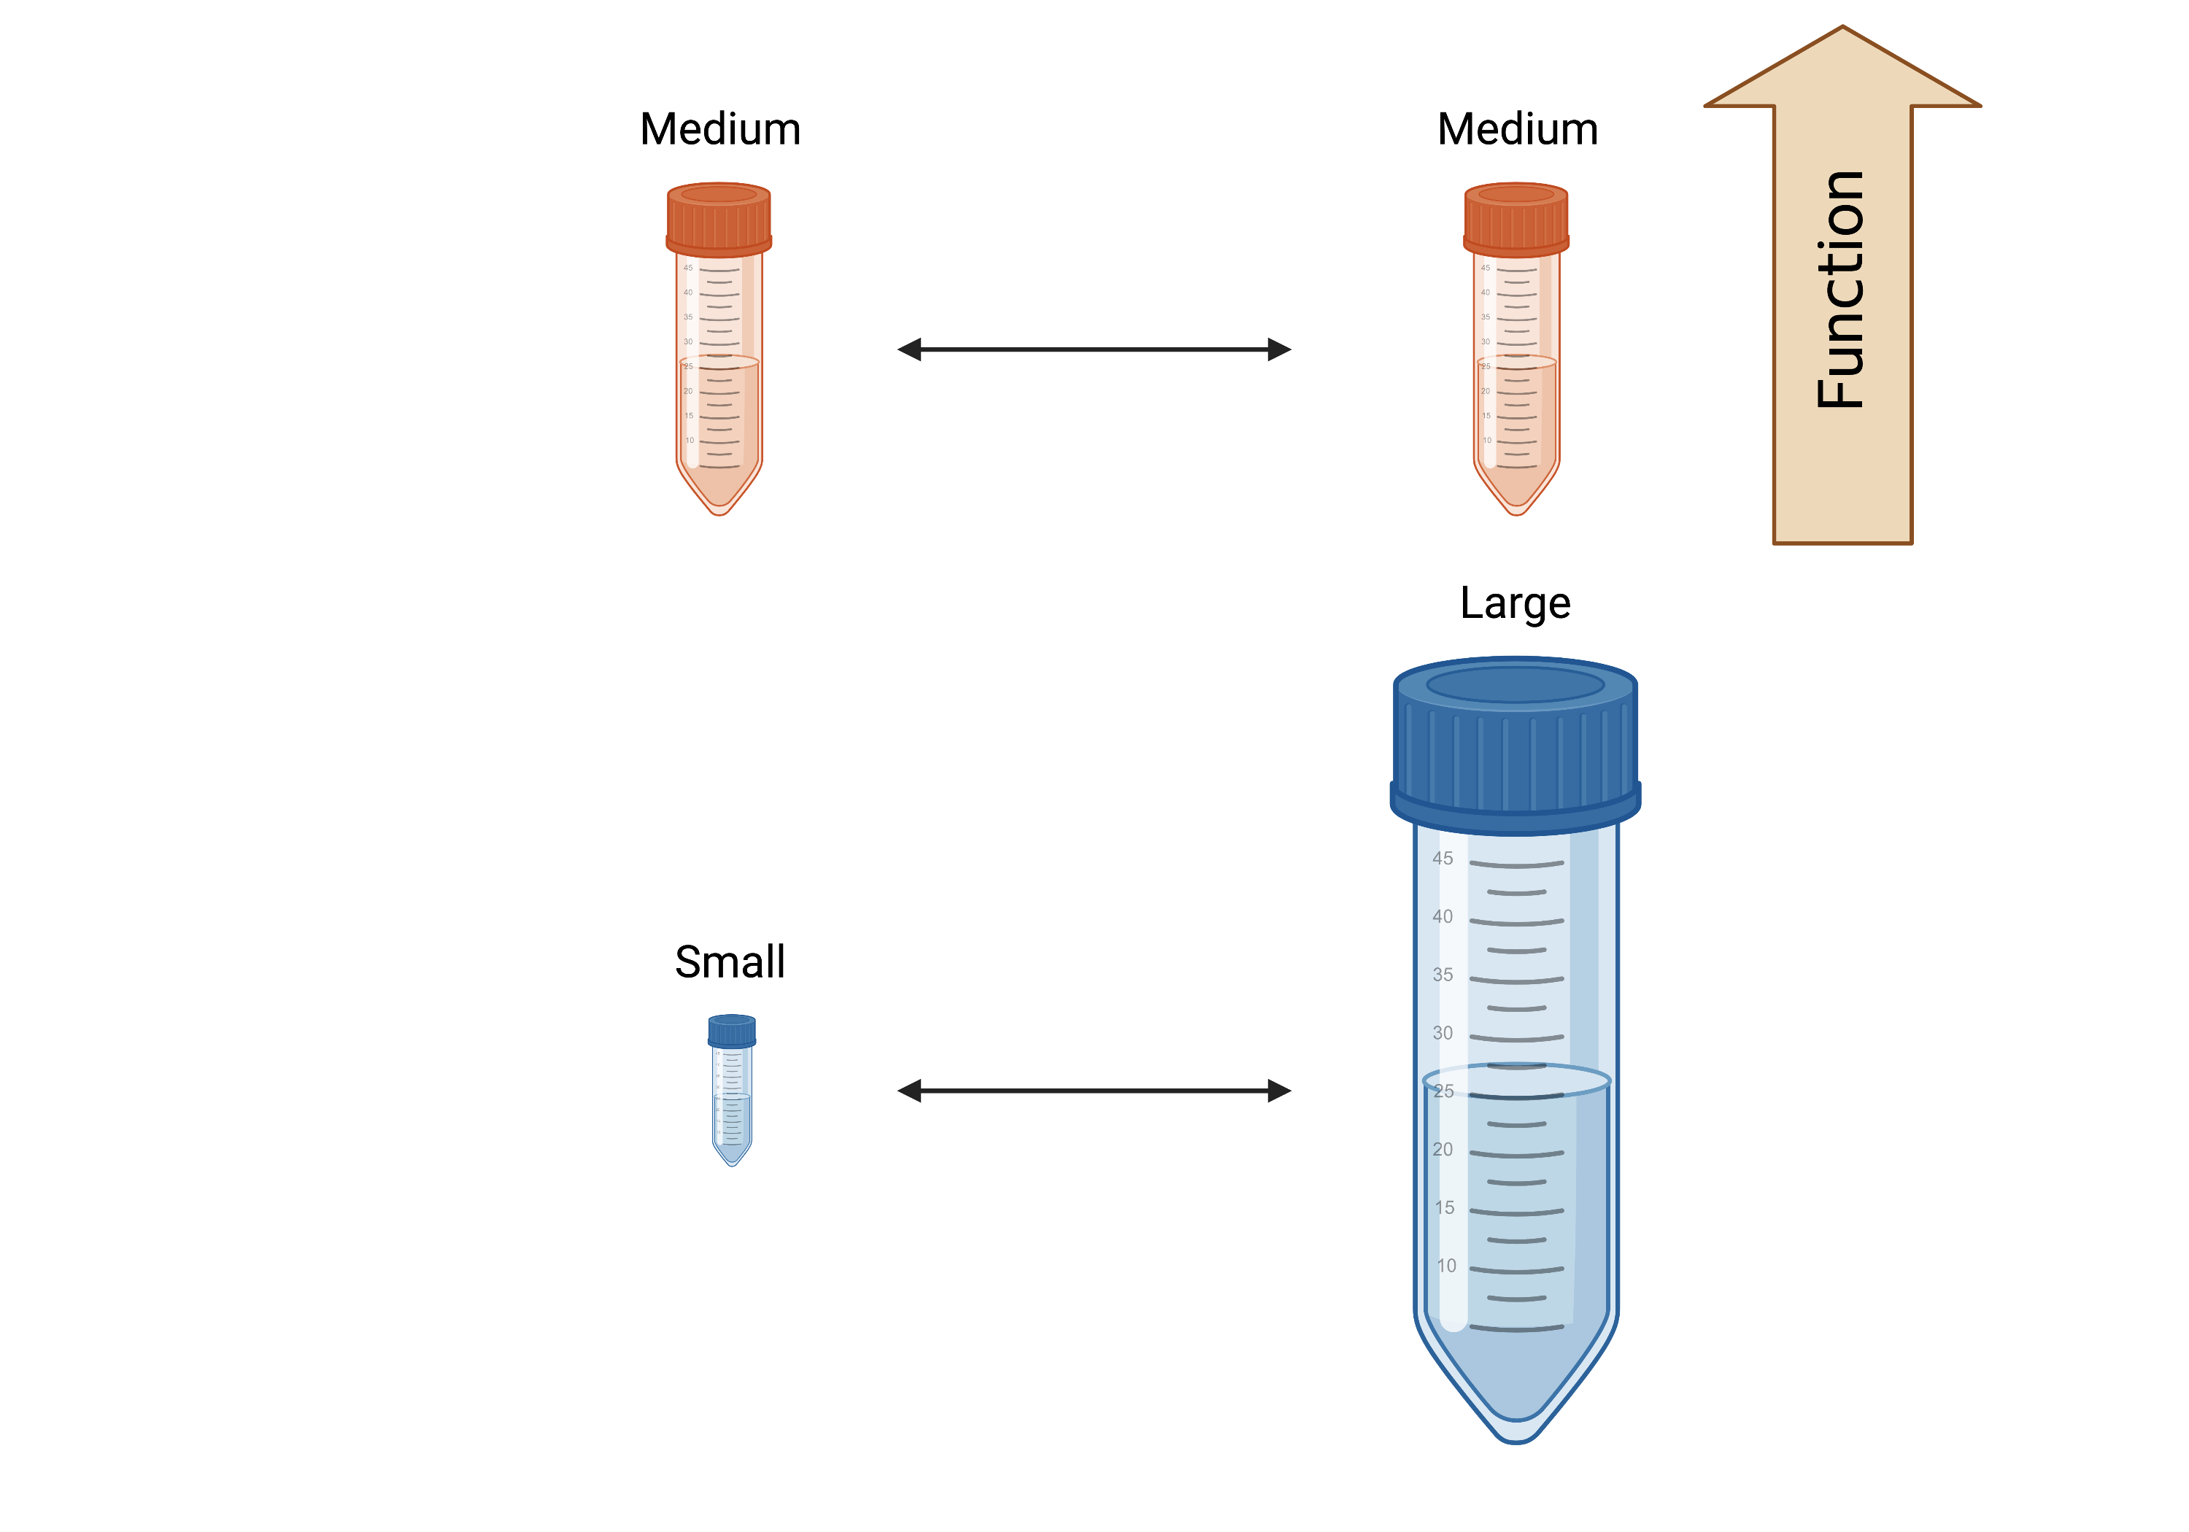
Conclusion
Patch level
Meta-ecosystem level
Because of size? Because of resource flow?
Waiting to run analysis (copy code from Ch2)
Notes:
Meta-ecosystem dynamics seem to depend on the relative size of its patches. The function of small patches increases when they receive resources coming from larger ecosystems. In regards to large patches, it would probably depend on how large they are. Probably at really large sizes, such as the one in our experiment, receiving little detritus from small ecosystems doesn’t change its function. However, it would probably happen when larger sizes are not way larger. The function of the meta-ecosystem will depend ultimately on two things: (1) How size itself changes the function of the patches and (2) Whether the increase in function of the small ecosystem is stronger than the decrease in function in the large ecosystem. We hopefully will be able to answer it analysing the effect of resource flow.

Slide 19
FUNCTION
Gounand, I., Harvey, E., Little, C. J., & Altermatt, F. (2018). Meta-ecosystems 2.0: rooting the theory into the field. Trends in Ecology & Evolution, 33(1), 36-46.
Notes:
- Different types of ecosystems that exchange different things.

Slide 20
Experiment 2: effect of patch size & trophic type

Slide 21
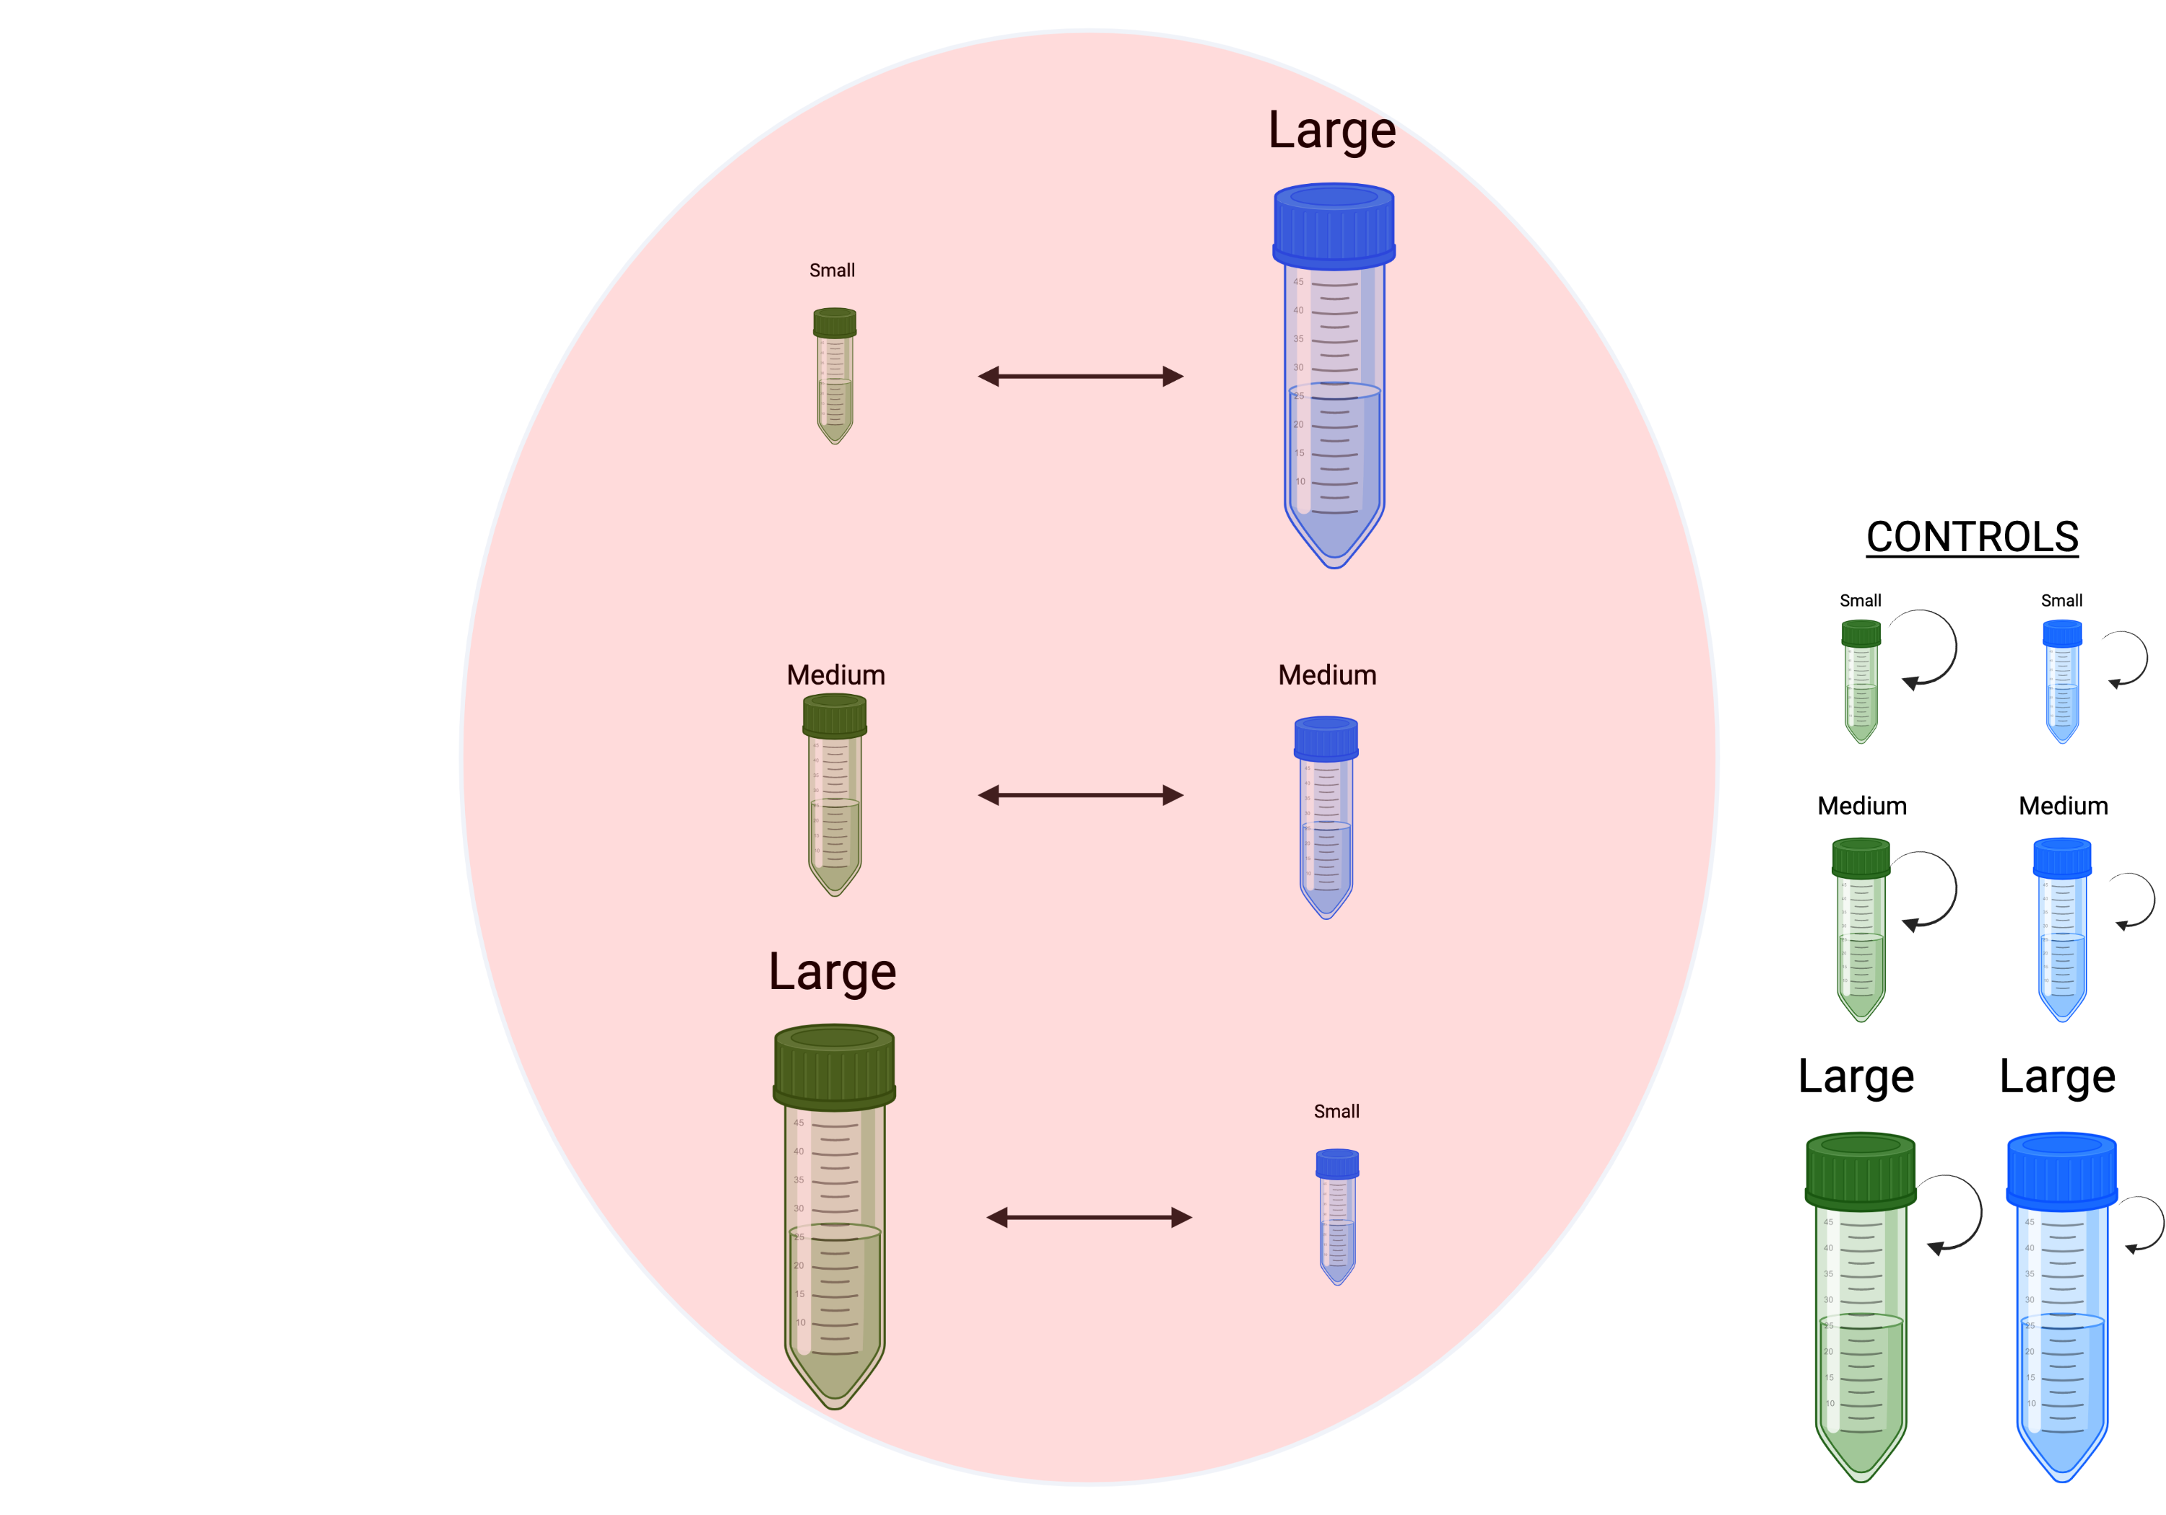
Add community composition
5.25 ml
Same total volume
5.25 ml
5.25 ml

Slide 22
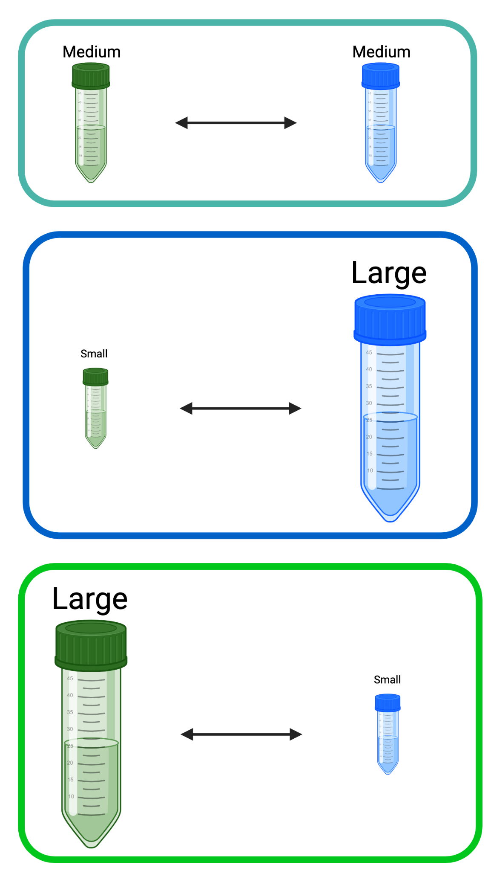
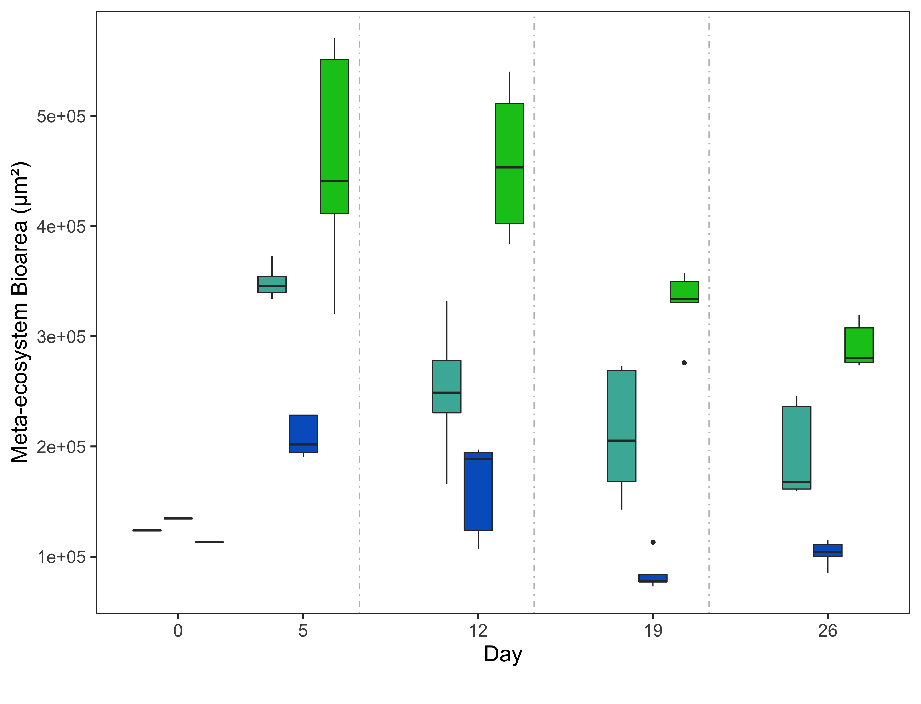

Slide 23
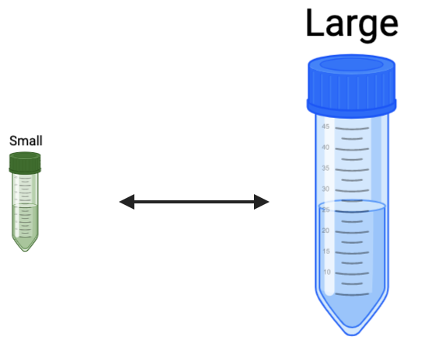
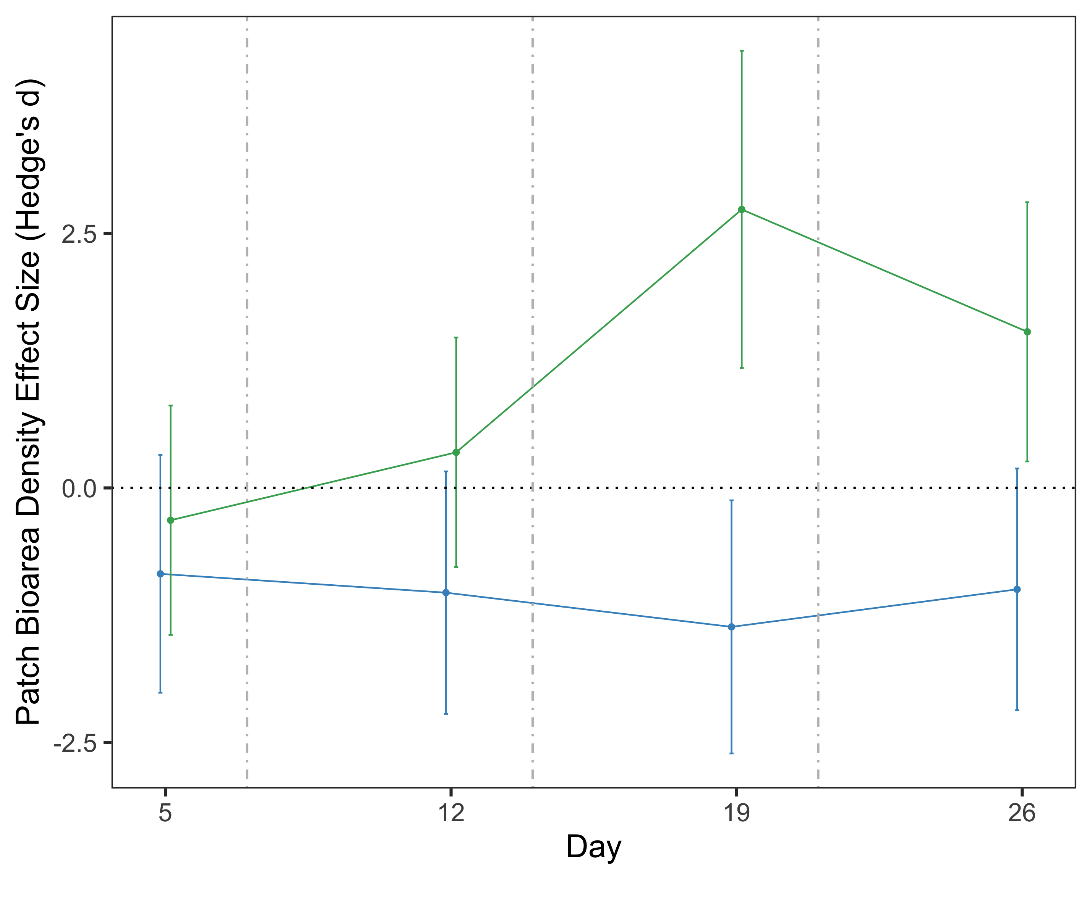

Slide 24
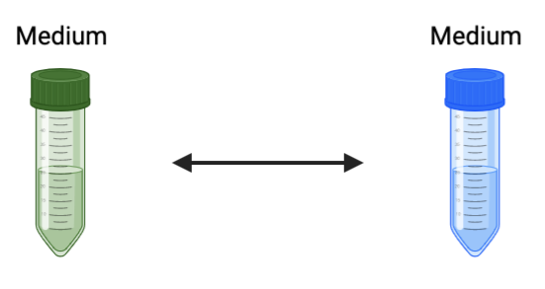
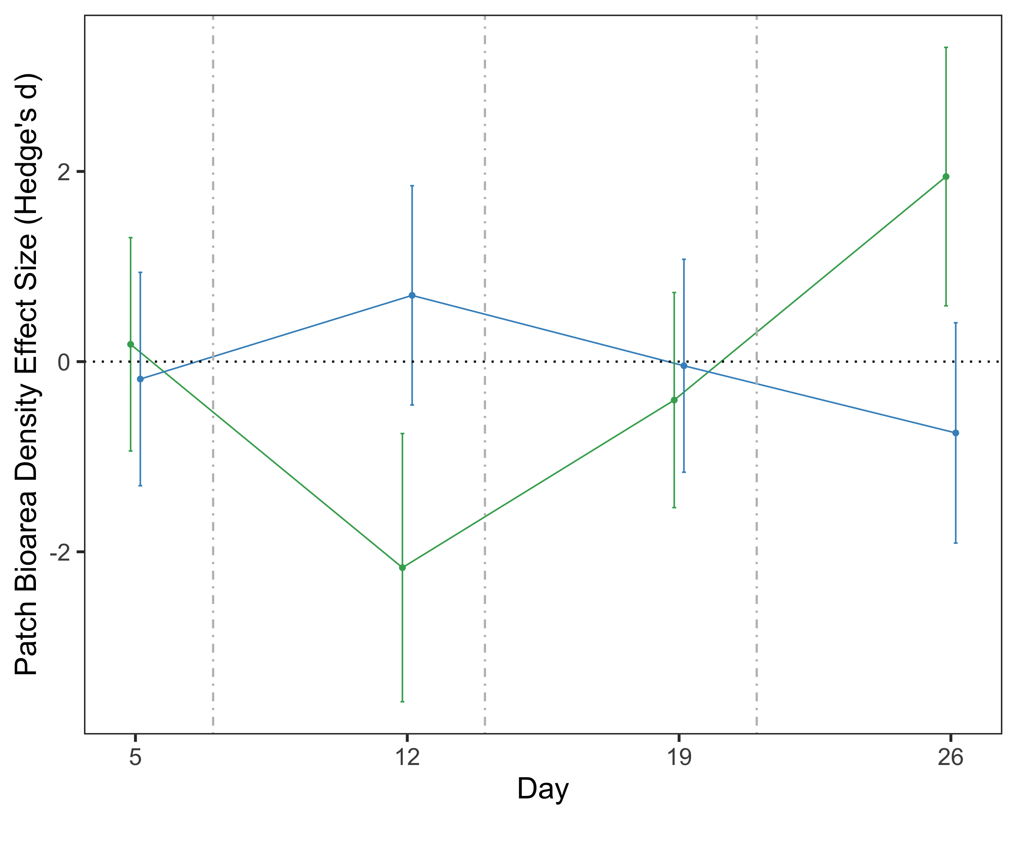

Slide 25
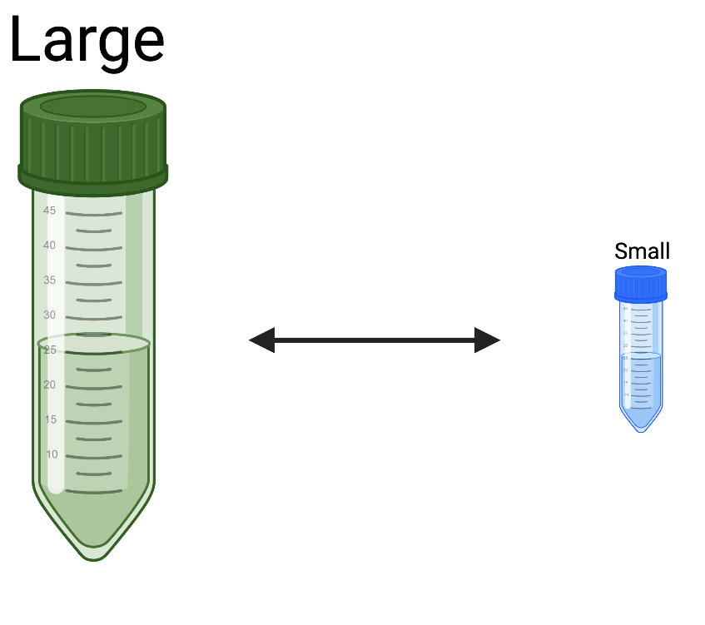
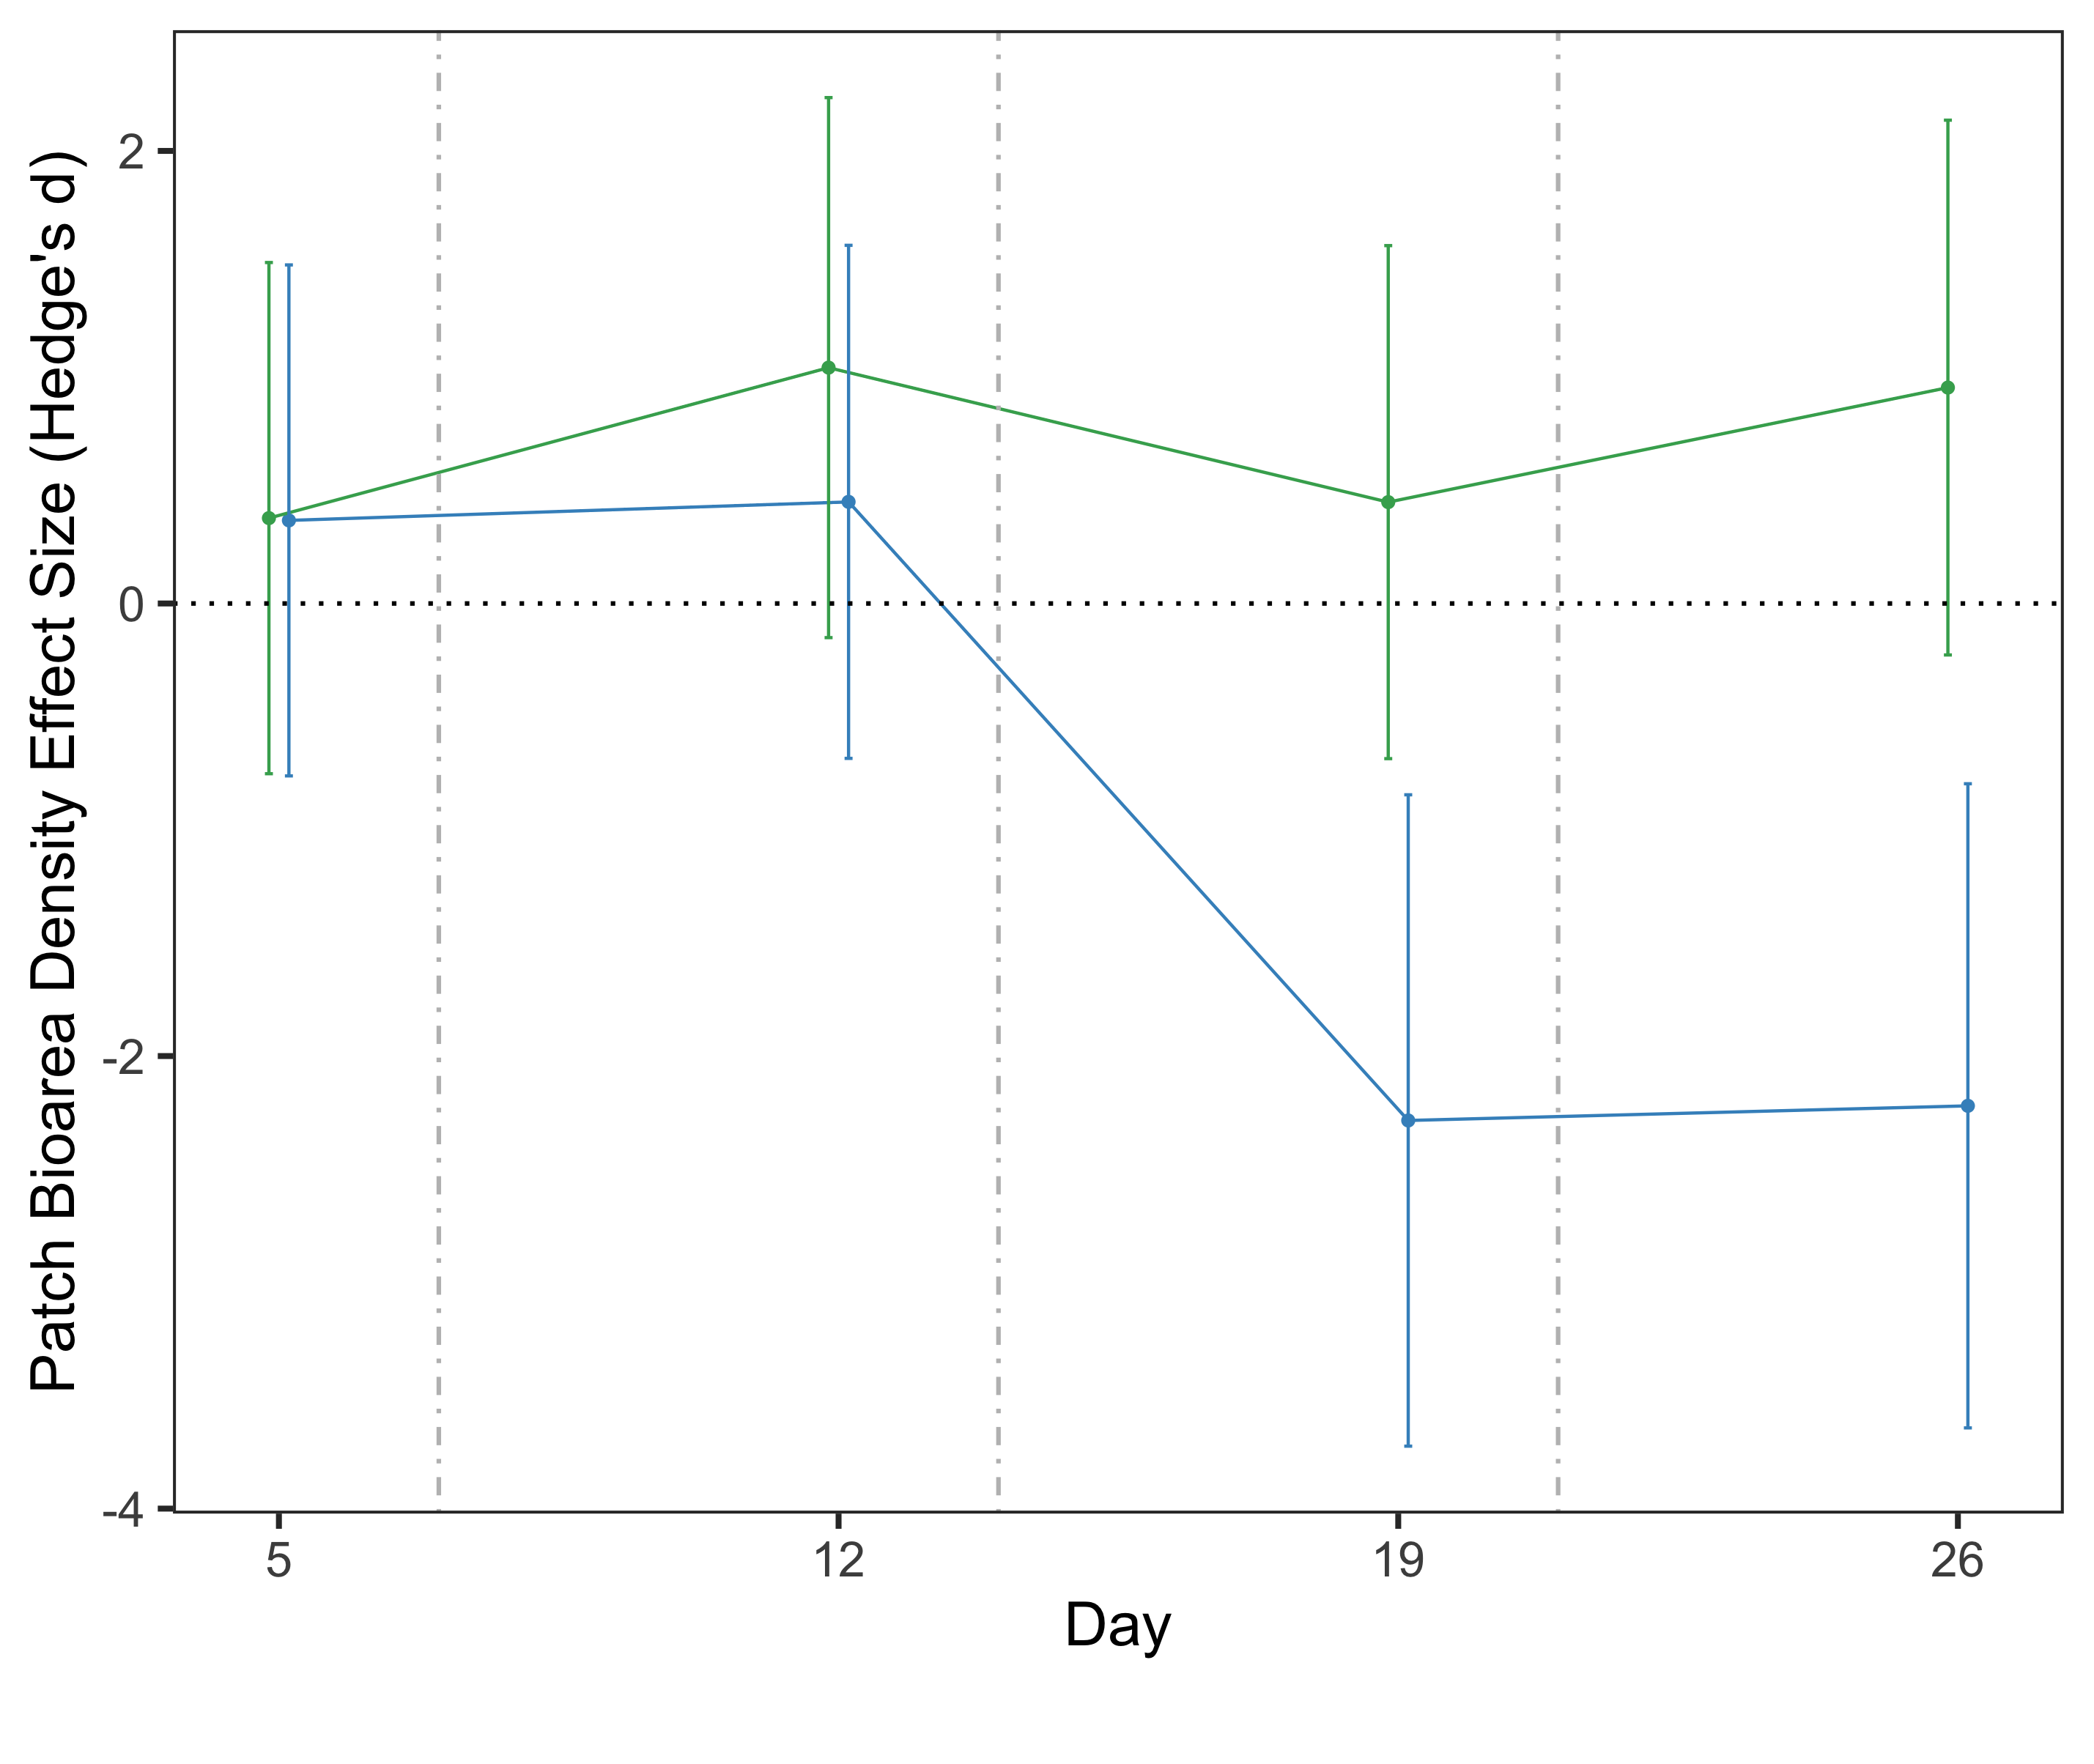

Slide 26
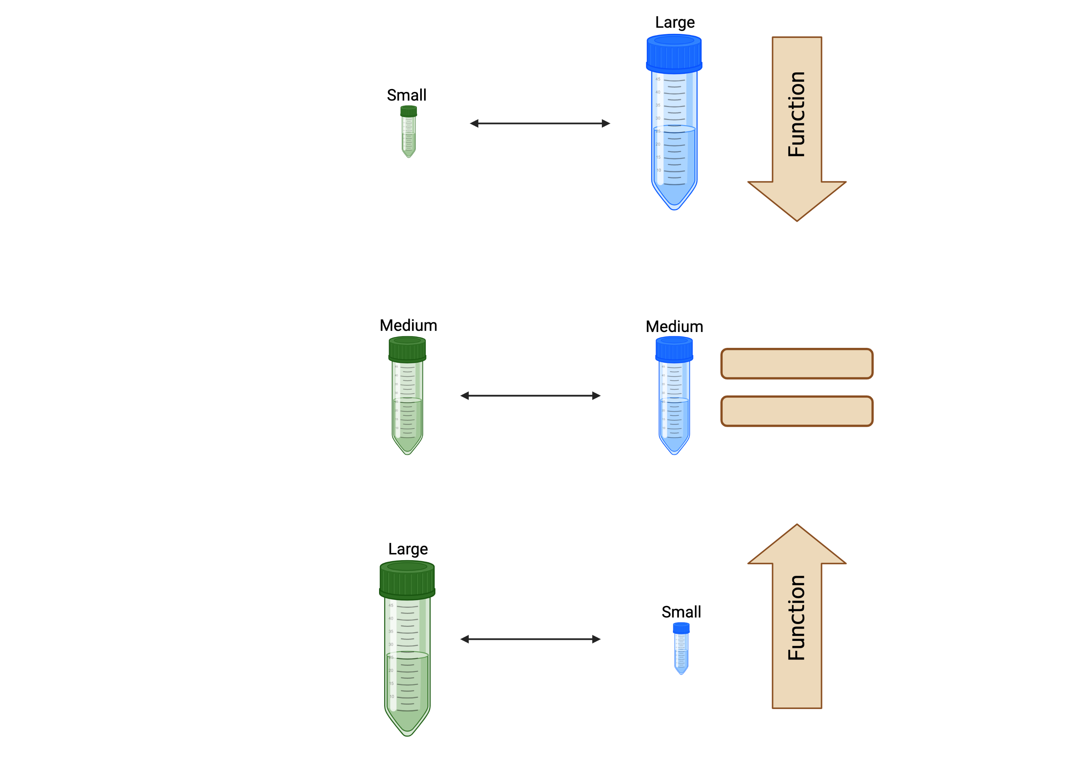
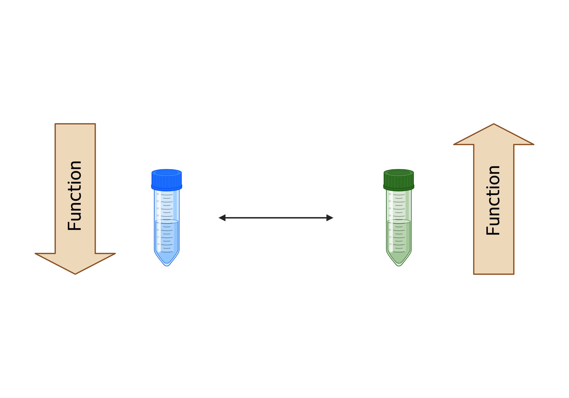
Conclusion
Patch level
Meta-ecosystem level
Community change?
Prevention of overshooting?
Because of relative size? Because of resource flow?

Slide 27
Experiment 3: effects of relative vs absolute flow

Slide 28
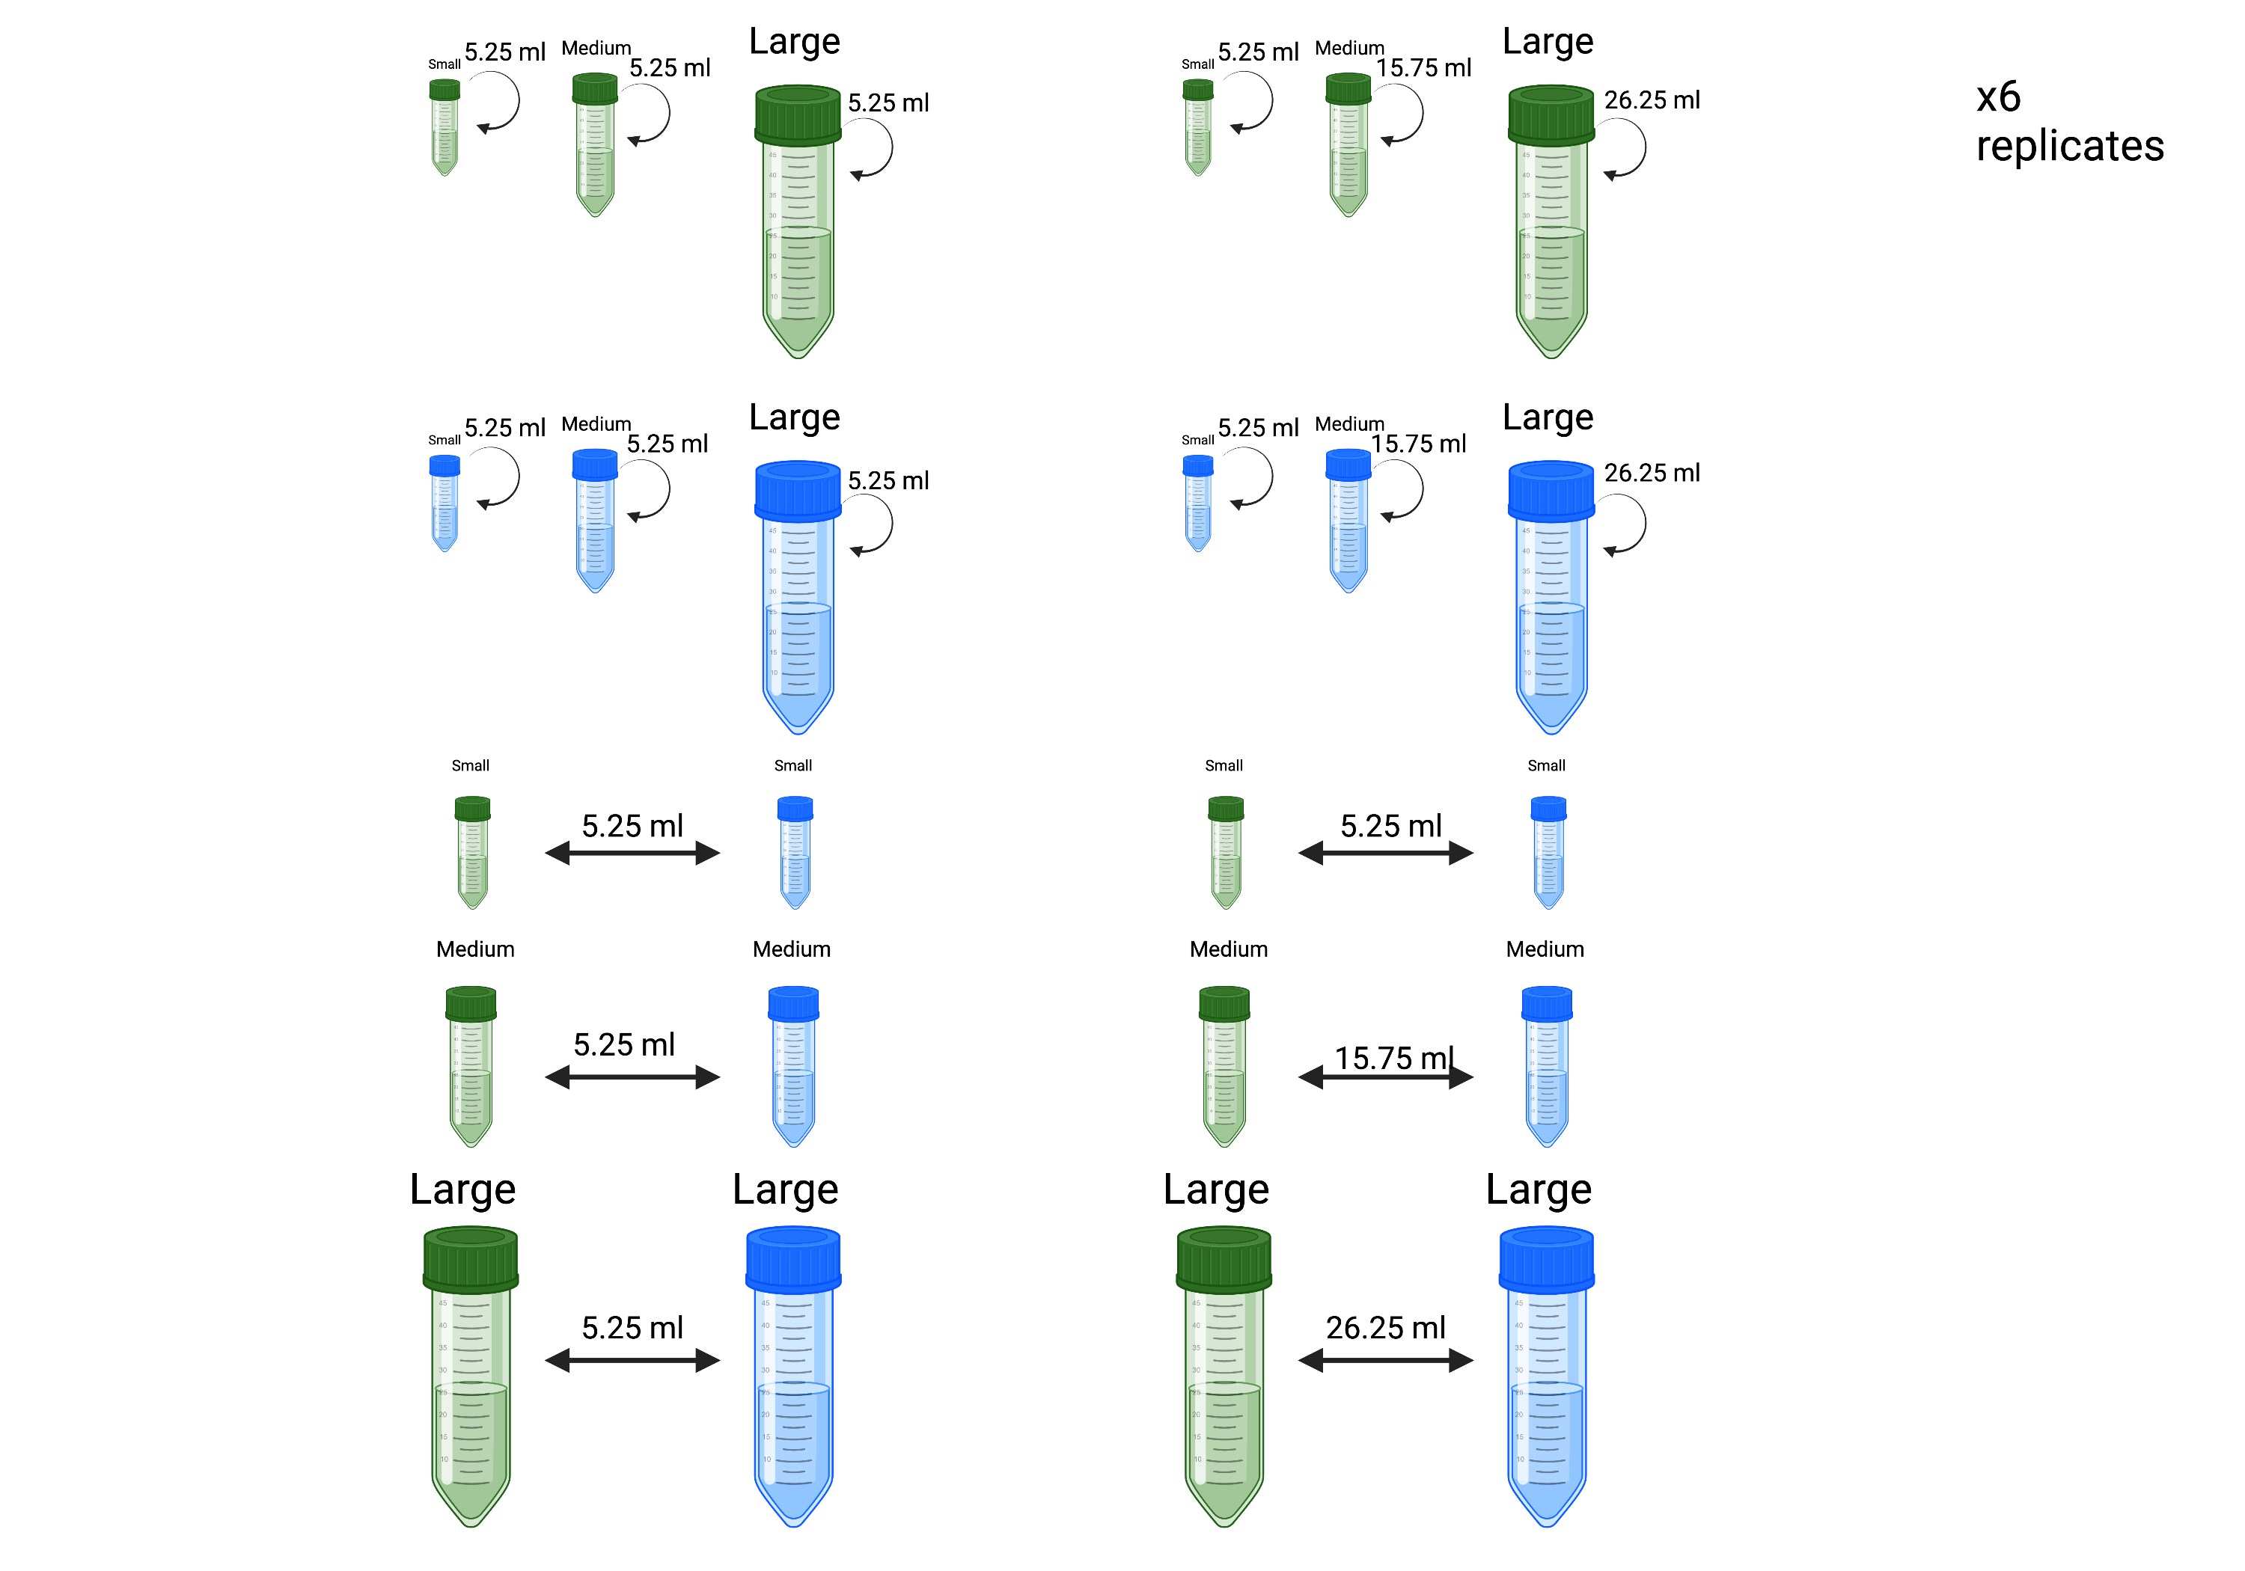

Slide 29
What I learned so far (other than that Protists are fun)
Meta-ecosytem level
Patch size matters and identity matters.
Patch level
The size of the donor ecosystem matters, but more the trophic type.

Slide 30








Thanks for listening to my talk!
Florian Altermatt
Tianna Peller
Isabelle Gounand
Silvana Käser
Samuel Hürlemann
Heng Zhang
Dario Jelmini
Mark Brandenberg

